Slide 1
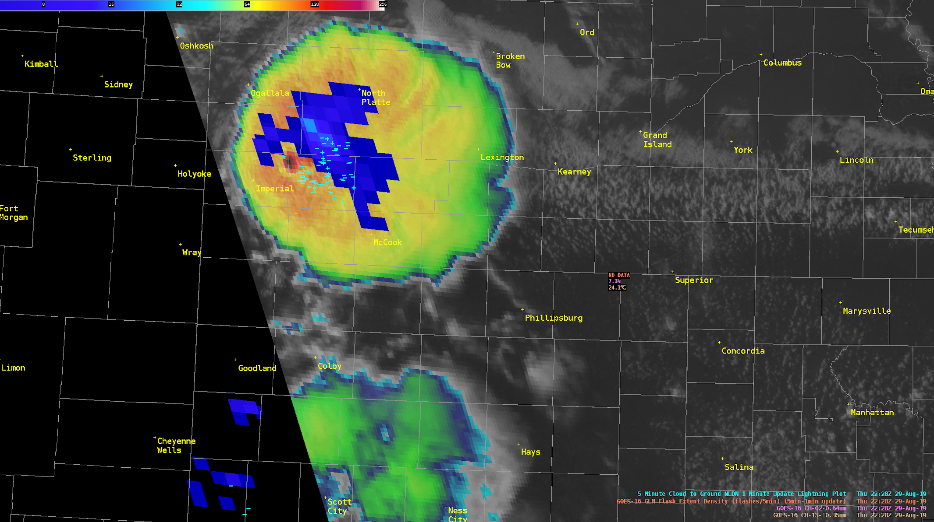
Mesoscale Analysis
And Forecasting
Bridging the Watch to Warning Gap
Material by:
Andrew Moore

Slide 2
What is Mesoanalysis?
Mesoanalysis:
Utilizing observations, short-range guidance, and meteorological concepts to anticipate convective evolution within meso spatial and temporal scales.
… Or in other words:
Anticipate potential storm hazards prior to the issuance of a warning!

Slide 3
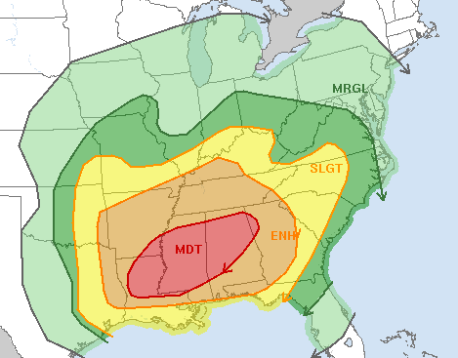
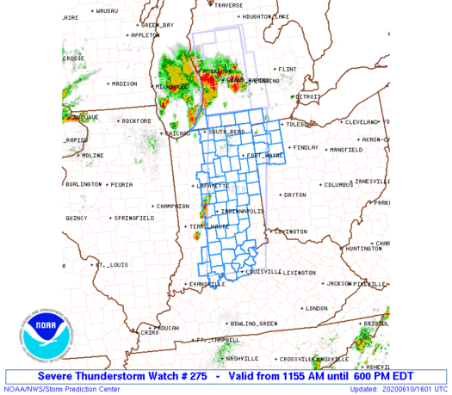
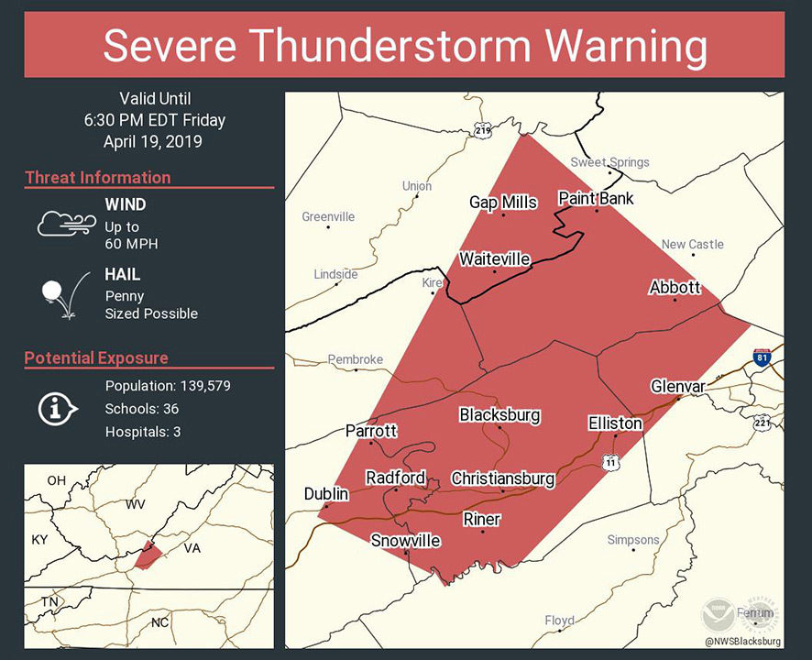
Outlooks
Synoptic Scale
Watches
Meso-Alpha Scale
Warnings
Storm Scale
1-8 Days
1-4 Hours
30-60 minutes

Slide 4
Outlooks
Synoptic Scale
Watches
Meso-Alpha Scale
Warnings
Storm Scale
1-8 Days
1-4 Hours
30-60 minutes
Watch - Warning Gap!

Slide 5
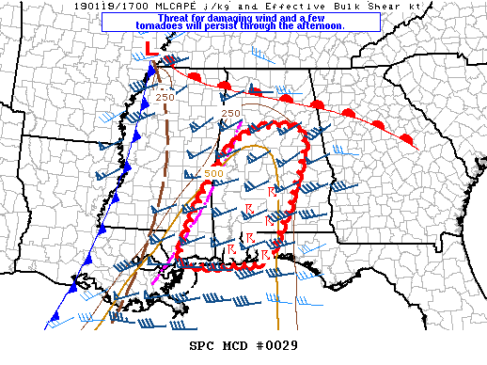
Mesoanalysis
Meso-Alpha to Beta Scale
Outlooks
Synoptic Scale
Watches
Meso-Alpha Scale
Warnings
Storm Scale
1-8 Days
1-4 Hours
0-2 Hours
30-60 minutes

Slide 6
Mesoanalysis
Meso-Alpha to Beta Scale
Outlooks
Synoptic Scale
Watches
Meso-Alpha Scale
Warnings
Storm Scale
1-8 Days
1-4 Hours
0-2 Hours
30-60 minutes
Anticipate potential storm local to regional hazards prior to the issuance of a warning!

Slide 7
Why Care About Mesoanalysis?
Changes philosophy from “reactive” to “proactive”!
This can aid in:
Enhanced lead time for the public
  Done through non-warning methods (such as NWS Chat, phone calls, text messages, social media graphics, etc…)
  Consider groups that need extra lead time like hospitals, nursing homes, outdoor events, etc…
Warning Type Decisions
Polygon (Warning Shape) Decisions
Builds trust between NWS, partners, and public

Slide 8
Who Does Mesoanalysis
Everyone can do mesoanalysis!
SPC issues Mesoscale Convective Discussions:
  Typically ahead of watch issuances
  To update ongoing watches
  To highlight a corridor of enhanced severe potential
  Purpose is to serve as a “heads up” to WFOs and other partners
WFOs do mesoanalysis to aid in warning decisions
  Will work more closely with local partners, broadcast media, and public.
Students can do mesoanalysis to help build their intuition of convective evolution!

Slide 9
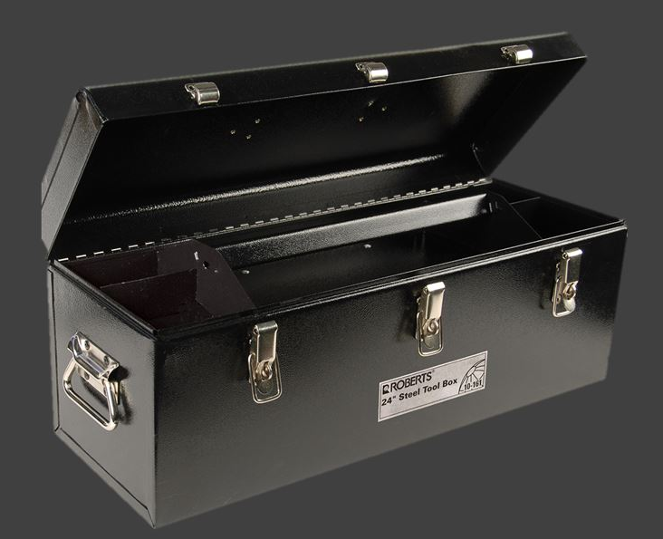
How do we do Mesoanalysis?
Get to know your tools:
Radar, Satellite, Surface Obs, RAP Mesoanalysis Fields, VWPs, ACARs, Soundings, etc...
Mesoscale Meteorology, Storm Scale Dynamics, Thermodynamics, etc...
RAP, HRRR, HREF, other experimental guidance...

Slide 10
How do we do Mesoanalysis?
General Methodology
Analyze ongoing weather!
  Are storms ongoing or imminent?
  Characterize the instability/shear
  What type of forcing for ascent?
  Are there any boundaries?
  Is model guidance handling the scenario well?
3. Utilize Guidance
Check again to ensure guidance is on the right track.
If so, use it to build confidence that you’re anticipating the correct most likely scenario.
2. Apply Meteorological Concepts
Anticipate storm mode/evolution over the next 0-4 hours
Anticipate potential hazards
Consider a range of possible outcomes

Slide 11
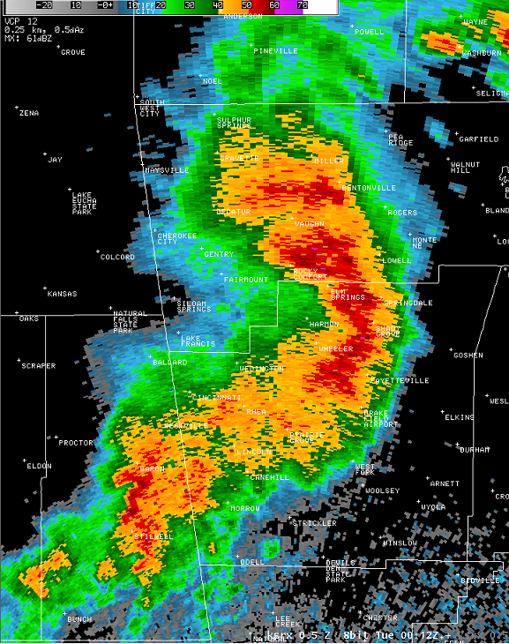
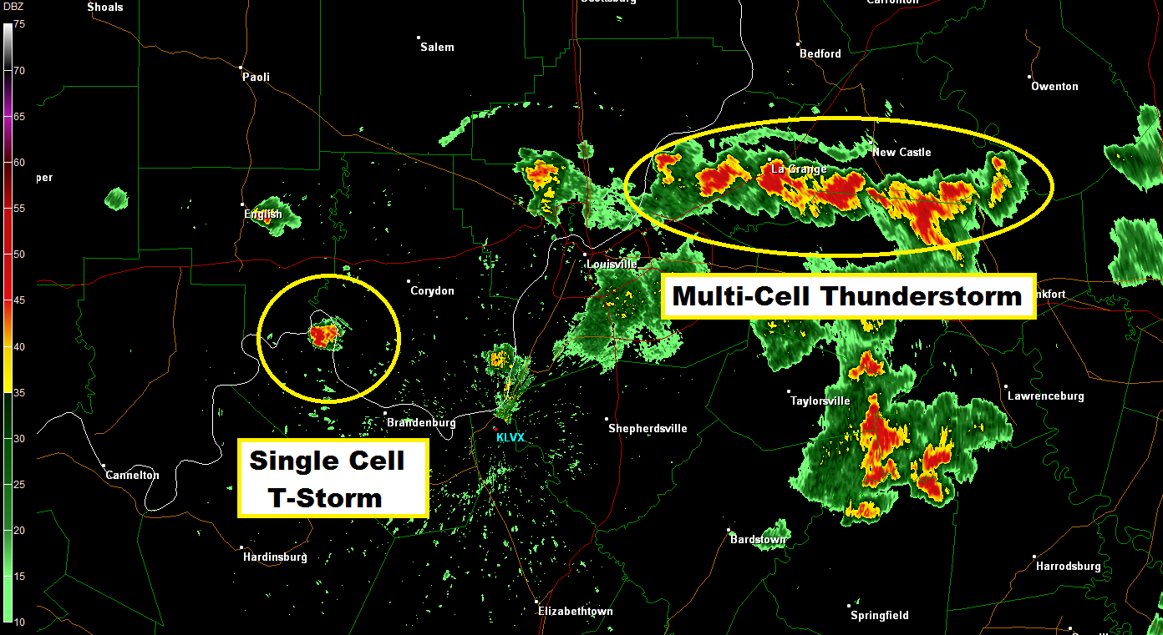
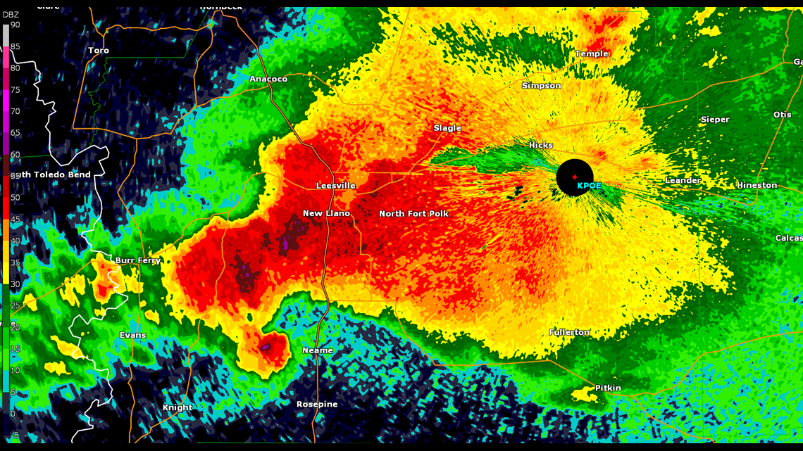
Storm Mode Spectrum
How do we anticipate the storm mode?

Slide 12
Storm Mode Basics
All of these must be taken into account to anticipate storm mode for the first few hours after convective initiation.
Consider each of these:
Boundary-relative storm motion
Boundary-relative deep-layer shear
Storm-relative anvil-level winds
Strength of forcing for ascent
Strength of capping
Numerous combinations are possible!

Slide 13
Storm Mode Basics
Boundary = zone of ascent
Boundary Motion (B) = (0,0)
Consider each of these:
Boundary-relative storm motion
Boundary-relative deep-layer shear
Storm-relative anvil-level winds
Strength of forcing for ascent
Strength of capping
U components
V components
storm motion (c) = (20,0)
Boundary-relative storm motion (Cb) = c - B
Cb = ((20- 0), (0 - 0))
Cb = (20,0)
Result: Storm moves off boundary;
favorable for discrete convection!

Slide 14
Storm Mode Basics
Boundary = zone of ascent
Boundary Motion (B) = (20,0)
Consider each of these:
Boundary-relative storm motion
Boundary-relative deep-layer shear
Storm-relative anvil-level winds
Strength of forcing for ascent
Strength of capping
storm motion (c) = (20,0)
Boundary-relative storm motion (Cb) = c - B
Cb = ((20- 20), (0 - 0))
Cb = (0,0)
Result: Storm remains on boundary;
Enhances residence time, promotes upscale growth!

Slide 15
Storm Mode Basics
Boundary = zone of ascent
Boundary Motion (B) = (20,20)
Consider each of these:
Boundary-relative storm motion
Boundary-relative deep-layer shear
Storm-relative anvil-level winds
Strength of forcing for ascent
Strength of capping
storm motion (c) = (10,10)
Boundary-relative storm motion (Cb) = c - B
Cb = ((10- 20), (10 - 20))
Cb = (-10,-10)
Result: Storm motion behind boundary;
Enhances residence time, promotes upscale growth!

Slide 16
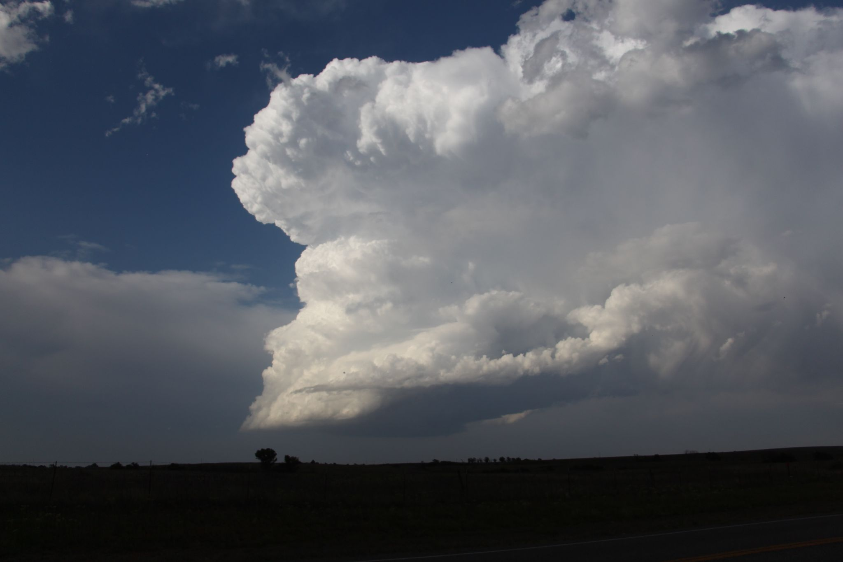
Storm Mode Basics
Downshear Pressure Perturbation
Effective BWD Vector
Consider each of these:
Boundary-relative storm motion
Boundary-relative deep-layer shear
Storm-relative anvil-level winds
Strength of forcing for ascent
Strength of capping
Convergence
(high pressure perturbation)
Divergence
(low pressure perturbation)

Slide 17
Storm Mode Basics
Downshear Pressure Perturbation
Effective BWD Vector
Consider each of these:
Boundary-relative storm motion
Boundary-relative deep-layer shear
Storm-relative anvil-level winds
Strength of forcing for ascent
Strength of capping
Convergence
(high pressure perturbation)
Divergence
(low pressure perturbation)
Induced
subsidence
Induced
ascent

Slide 18
Storm Mode Basics
Off Boundary
Effective BWD Vector
Consider each of these:
Boundary-relative storm motion
Boundary-relative deep-layer shear
Storm-relative anvil-level winds
Strength of forcing for ascent
Strength of capping
The deep-layer shear vector orients the precipitation distribution away from the updraft (ex: size sorting)
Off-boundary deep-layer shear vectors favor precipitation distributions away from neighboring cells
Also favors downshear updraft development into warm sector, which favors discrete cells.

Slide 19
Storm Mode Basics
Along Boundary
Effective BWD Vector
Consider each of these:
Boundary-relative storm motion
Boundary-relative deep-layer shear
Storm-relative anvil-level winds
Strength of forcing for ascent
Strength of capping
Deep-layer shear vectors along the boundary favor precipitation (and outflow/cold pool) distributions towards the updraft regions of neighboring storms.
Also favors downshear updraft development in close proximity to neighboring storms.
This tends to favor cold pool amalgamation and upscale growth.

Slide 20
Storm Mode Basics
Anvil-level SR wind
Consider each of these:
Boundary-relative storm motion
Boundary-relative deep-layer shear
Storm-relative anvil-level winds
Strength of forcing for ascent
Strength of capping
The anvil-level storm relative (SR) winds influence storm morphology similar to the deep-layer shear vector.
They influence downstream anvil shading and seeding of new updrafts from fallout hydrometeors
Z
Y
Storm motion
X

Slide 21
Storm Mode Basics
Along Boundary
Consider each of these:
Boundary-relative storm motion
Boundary-relative deep-layer shear
Storm-relative anvil-level winds
Strength of forcing for ascent
Strength of capping
Anvil-level SR wind
Along-boundary anvil-level SR winds tend to seed new updrafts in close proximity to neighboring storms.
This tends to favor upscale growth
Z
Y
Storm motion
X

Slide 22
Storm Mode Basics
Off Boundary
Consider each of these:
Boundary-relative storm motion
Boundary-relative deep-layer shear
Storm-relative anvil-level winds
Strength of forcing for ascent
Strength of capping
Anvil-level SR wind
Off-boundary anvil-level SR winds tend to seed new updrafts downstream into the warm sector.
This tends to favor discrete cells.
Z
Y
Storm motion
X

Slide 23
Storm Mode Basics
No Lift?
Consider each of these:
Boundary-relative storm motion
Boundary-relative deep-layer shear
Storm-relative anvil-level winds
Strength of forcing for ascent
Strength of capping
No storms!

Slide 24
Storm Mode Basics
Weak Ascent
Consider each of these:
Boundary-relative storm motion
Boundary-relative deep-layer shear
Storm-relative anvil-level winds
Strength of forcing for ascent
Strength of capping
Fewer initial cells, greater spacing between cells, less chance of storm interactions
(even if shear/anvil-level winds aren’t favorable)
This tends to favor discrete cells.
Weak forcing mechanisms:
Drylines
Weak outflow boundaries
Confluence axes

Slide 25
Storm Mode Basics
Strong Ascent
Consider each of these:
Boundary-relative storm motion
Boundary-relative deep-layer shear
Storm-relative anvil-level winds
Strength of forcing for ascent
Strength of capping
More initial cells, smaller spacing between cells, higher chance of storm interactions
(even if boundary-relative storm motions are favorable for discrete)
This tends to favor upscale growth.
Strong forcing mechanisms:
Surging cold fronts
Strong outflow boundaries

Slide 26
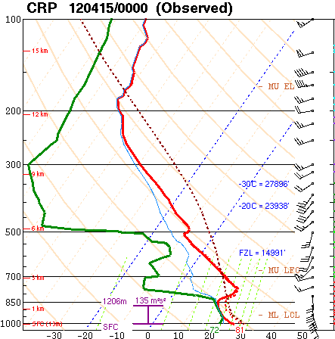
Storm Mode Basics
“Nuclear” cap?
Consider each of these:
Boundary-relative storm motion
Boundary-relative deep-layer shear
Storm-relative anvil-level winds
Strength of forcing for ascent
Strength of capping
No storms!

Slide 27
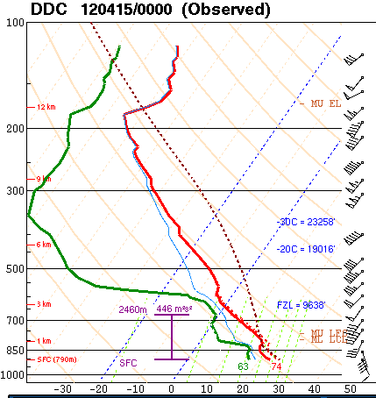
Storm Mode Basics
Weak cap?
Consider each of these:
Boundary-relative storm motion
Boundary-relative deep-layer shear
Storm-relative anvil-level winds
Strength of forcing for ascent
Strength of capping
Limits number of initial storms: favorable for discrete cells

Slide 28
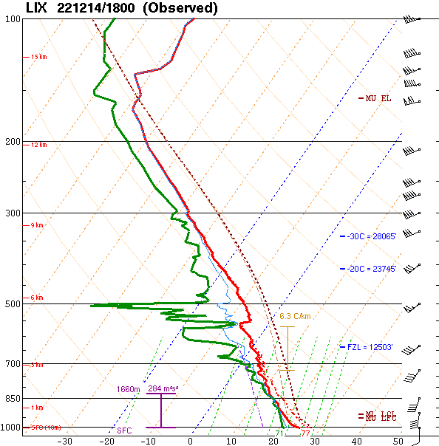
Storm Mode Basics
No cap?
Consider each of these:
Boundary-relative storm motion
Boundary-relative deep-layer shear
Storm-relative anvil-level winds
Strength of forcing for ascent
Strength of capping
Remember: numerous combinations are possible!
Allows for numerous storms, favors upscale growth

Slide 29
Storm Mode Basics
Consider each of these:
Boundary-relative storm motion
Boundary-relative deep-layer shear
Storm-relative anvil-level winds
Strength of forcing for ascent
Strength of capping
How do I weight each of these factors?

Slide 30
Storm Mode Basics
Consider each of these:
Strength of forcing for ascent
Boundary-relative storm motion
Boundary-relative deep-layer shear
Storm-relative anvil-level winds
Strength of capping
Primary influencing factor
Secondary influencing factors
Modulating factor

Slide 31
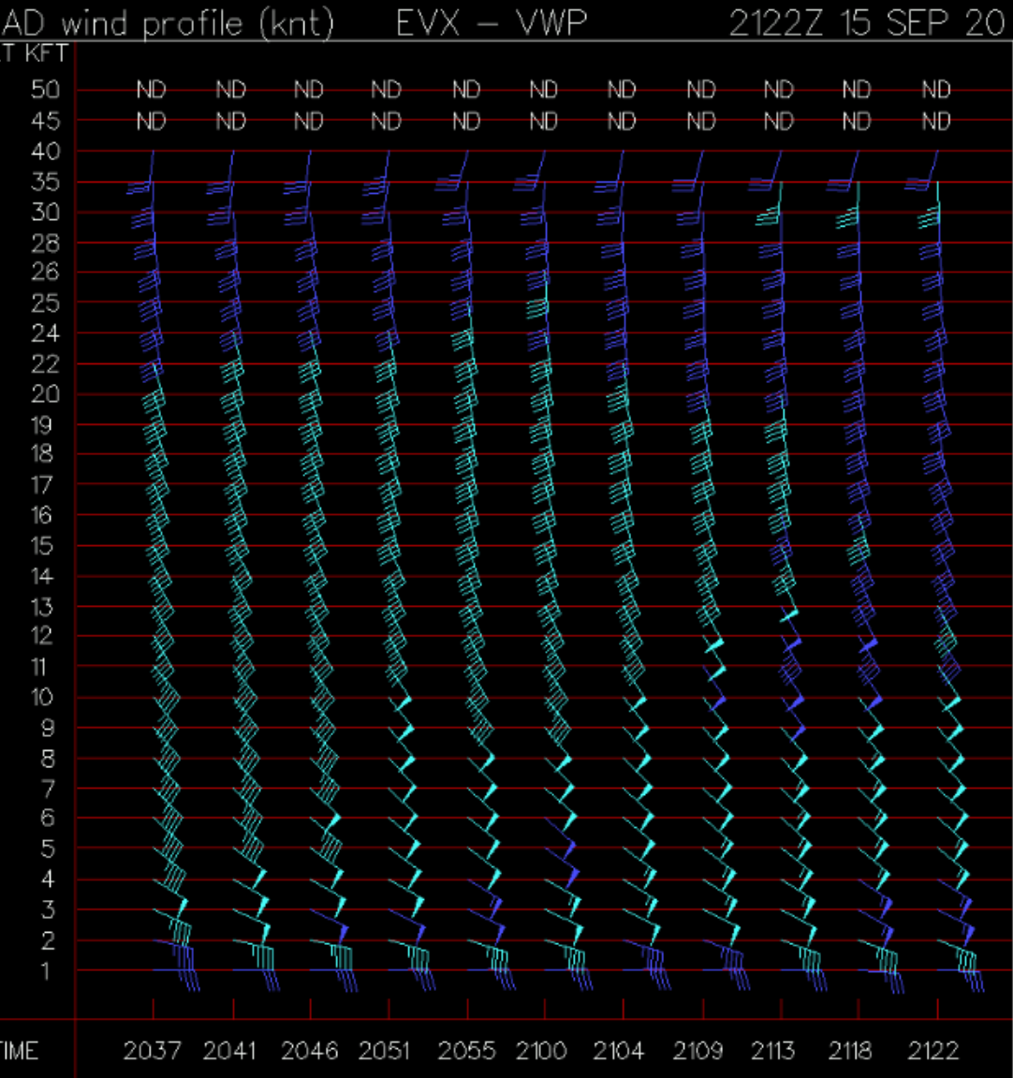
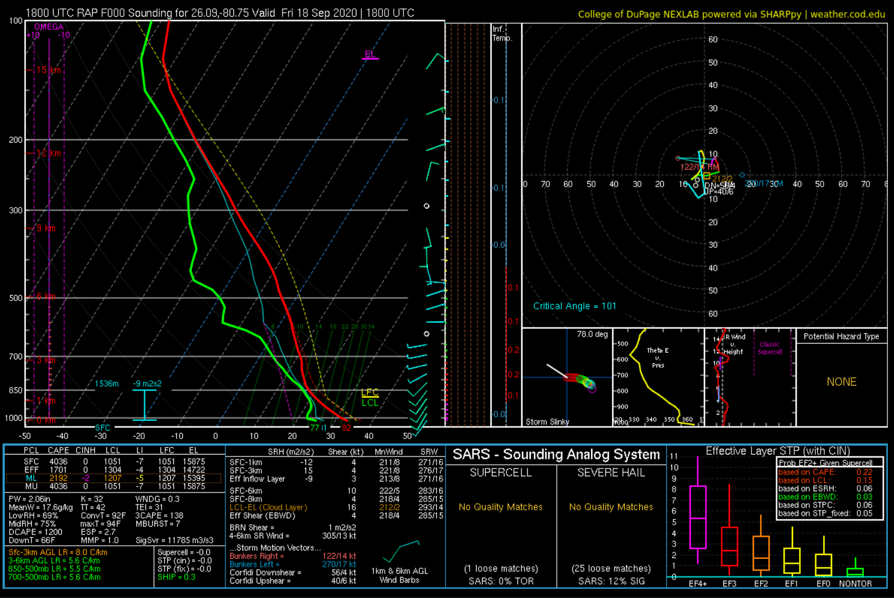
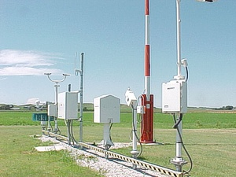
Let’s see an example!
In this exercise we will primarily be focusing on the tornado potential, but the concepts apply to other hazards as well.

Slide 32
Storm Mode In a nutshell
Storm mode is a function of:
Boundary-relative storm motion
  Storms move off boundary => favorable for discrete
  Storms stay on/move along boundary => favorable for linear
Orientation of deep layer shear vector relative to the boundary
  Shear vector off boundary => storm orients off-boundary => favorable for discrete
  Shear vector along boundary => storm orients along boundary => favorable for linear
Anvil level storm-relative winds
  Winds off boundary => Anvil debris less likely to “seed” neighboring storms along boundary => discrete
  Winds along boundary => Anvil debris more likely to “seed” neighboring storms along boundary => linear
Strength of the forcing for ascent
  Weak forcing for ascent => fewer storms => favorable for discrete
  Strong forcing for ascent => more storms => favorable for linear
For details: Dial et al. 2010, Short-term Convective Mode Evolution along Synoptic Boundaries
Notes:
Based on parameter space alone, the 2% tornado threat appears appropriate.

Slide 33
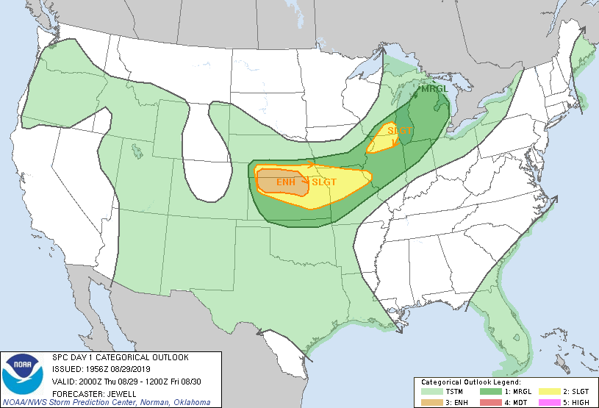
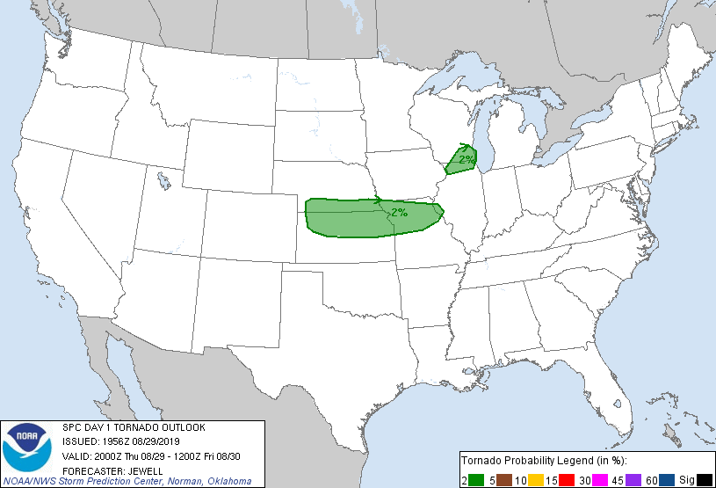
August 29, 2019 21 UTC
We’ll be focusing on southwest NE, northeast CO, and northwest KS
Notes:
We’ll start with RAP Mesoanalysis data to give us a general overview of the environment. Area of interest is southwest NE/northwest KS/northeast CO.

Slide 34
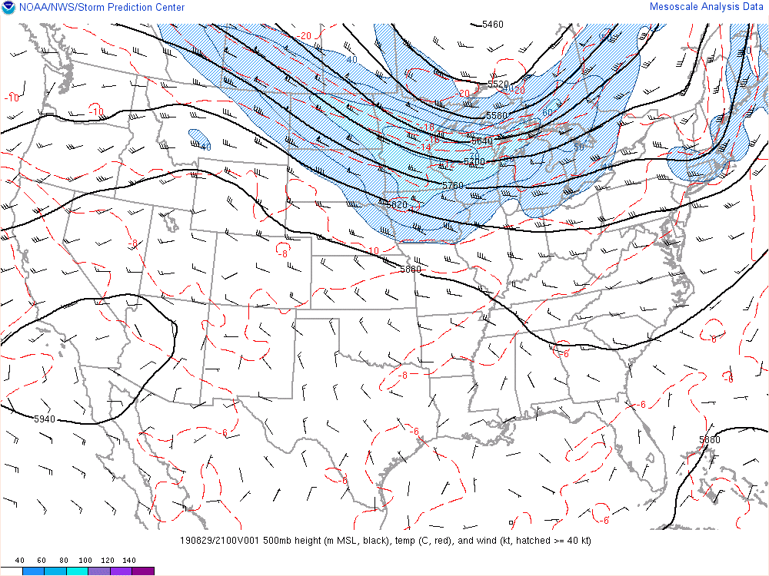
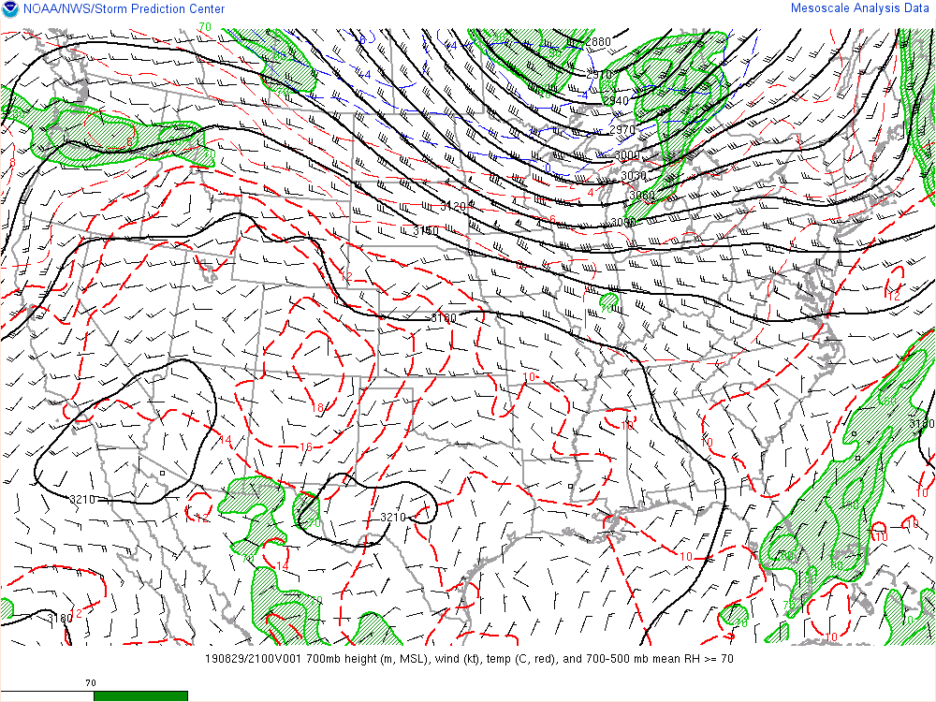
August 29, 2019 21 UTC
Notes:
We’ll start with RAP Mesoanalysis data to give us a general overview of the environment. Area of interest is southwest NE/northwest KS/northeast CO.

Slide 35
August 29, 2019 21 UTC
Q: Is there strong synoptic forcing for ascent?
Notes:
A: Not really. The impulse noted here is relatively weak (no strong height falls were noted, trough is not very amplified and flow is not very strong (so no strong QG forcing for ascent).
Also note, the warm temps at 700 mb may suggest a CAP and/or steep mid-level lapse rates.

Slide 36
August 29, 2019 21 UTC
Q: How would you characterize the flow?
Notes:
A: Not particularly strong. The stronger 500 mb flow is displaced to the north. What does this imply about the potential for strong wind shear?
A: Overly strong wind shear does not appear likely. However, shear may be sufficient for organized storms.

Slide 37
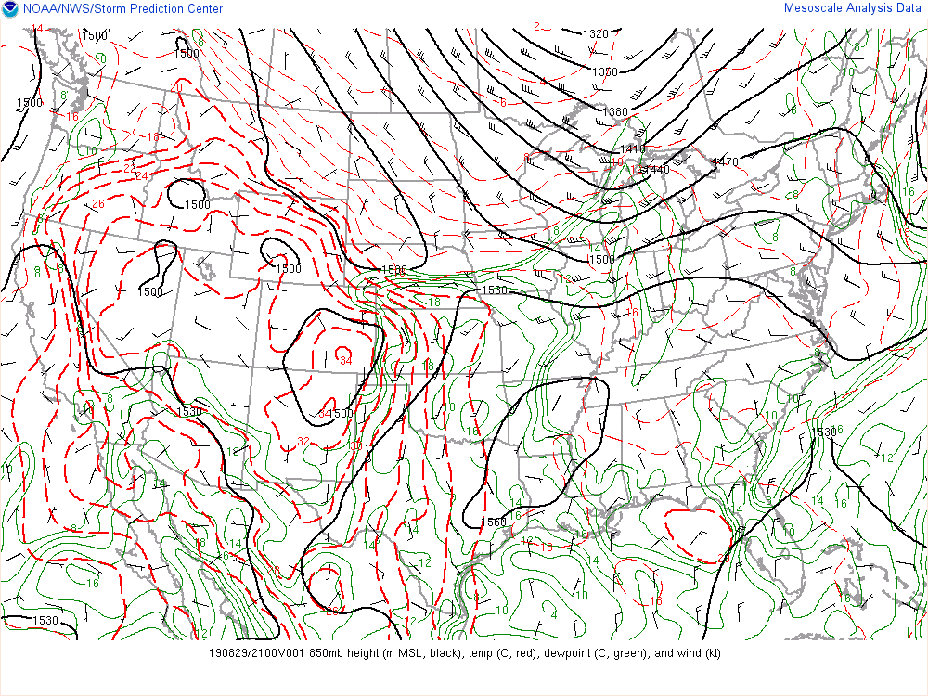
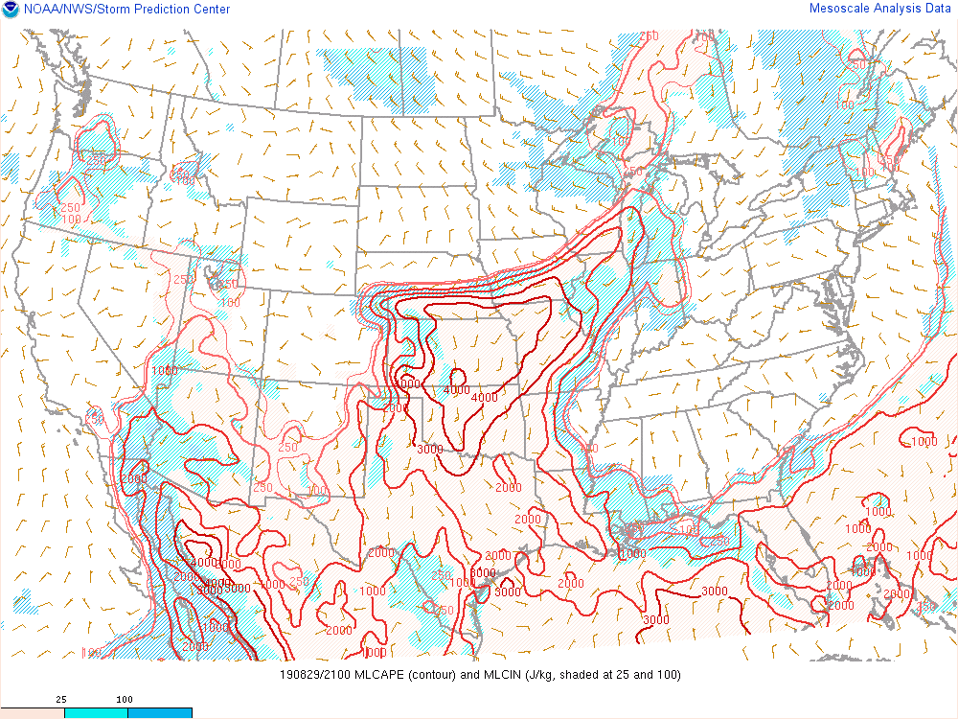
August 29, 2019 21 UTC
L
Q: Is there local/mesoscale forcing for ascent?
Notes:
A: Yes! There is a cold front/stationary boundary draped across the region.

Slide 38
August 29, 2019 21 UTC
L
Q: How would you characterize the instability?
Notes:
A: In the vicinity of the boundary, MLCAPE is on the order of 1000-2000 J/kg with higher values to the south/southeast. I would call this moderate instability.

Slide 39
August 29, 2019 21 UTC
L
Q: What does the thermal ridge at 850 mb say about potential capping?
Notes:
A: The warmer 850 mb temps over KS suggests that a stronger cap may be in place compared to locations further north closer to the front/boundary. This is reflected in the MLCAPE field where pockets of MLCIN are noted.

Slide 40
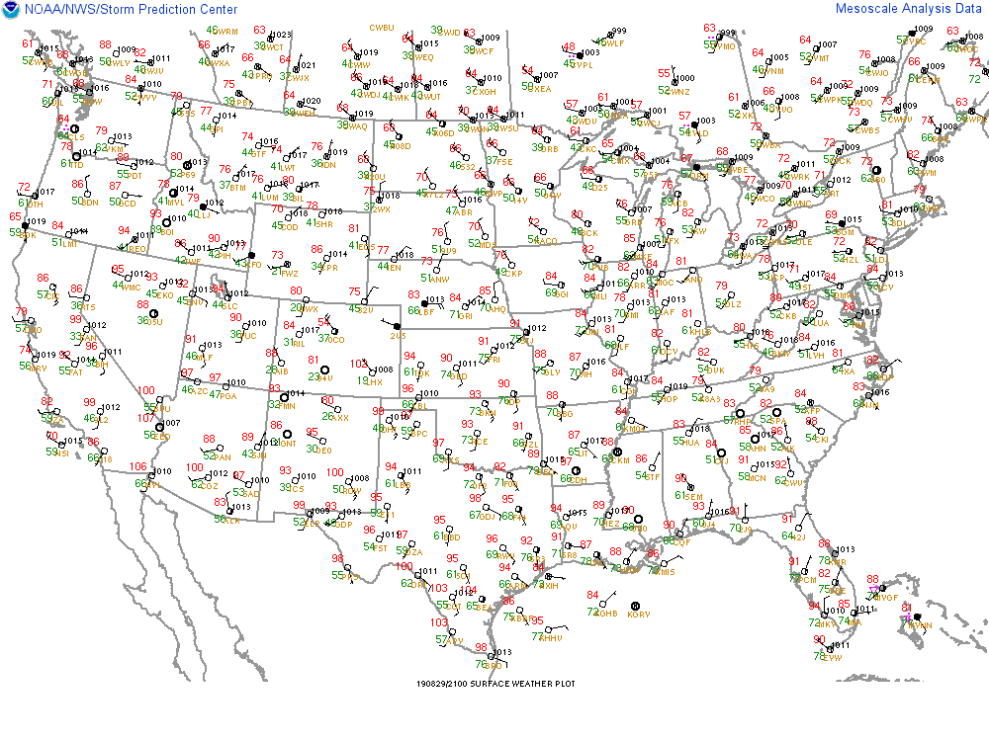
L
Q: How would you characterize the surface T/Td on either side of the boundary?
Notes:
A: If we do a quick, rough surface analysis we see the surface reflection of the low in southwest NE and the stationary boundary along the KS/NE border. The T/Td on the south side of the boundary are warm and moist (90s with mid 70s dewpoints).
The T/Td north of the boundary are slightly cooler, but still somewhat moist. This tells us that this boundary is not surging south rapidly (we would expect cooler/drier conditions if so). This also means the air to the north of the boundary may still be somewhat
Unstable from a surface parcel perspective.

Slide 41
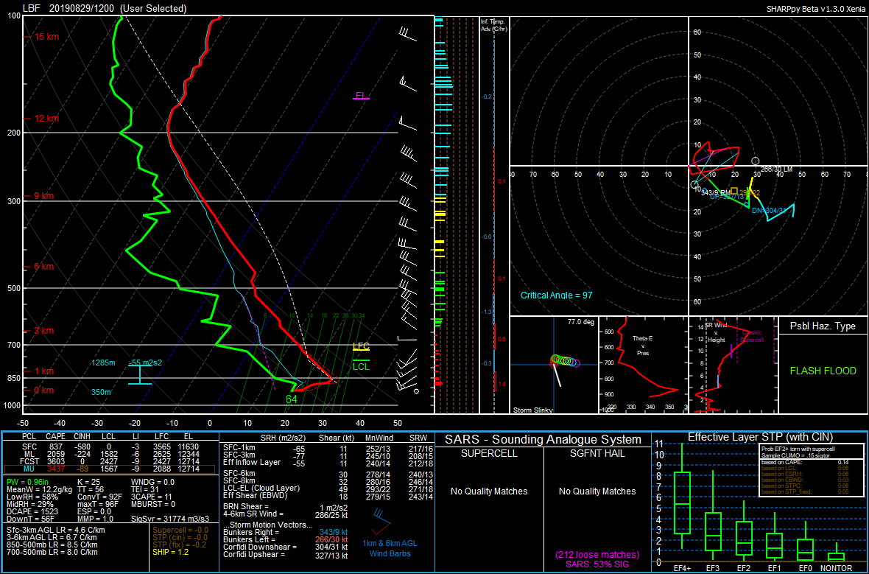
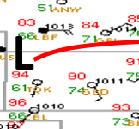
12 Z Observed
Notes:
Let’s take a look at the observed soundings. Notice the steep lapse rates? Now let’s adjust them based on recent surface observations from near the surface boundary.
This gives us an approximate picture of what the thermo environment looks like.

Slide 42
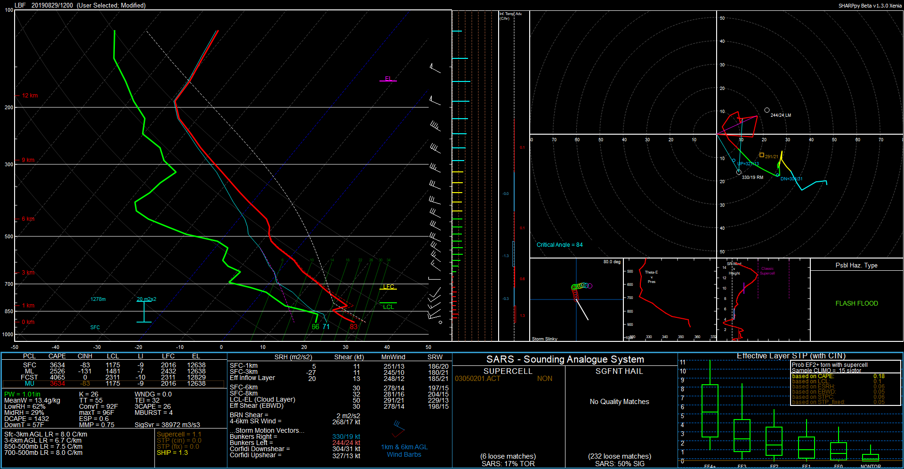
12 Z Modified
(based on 21 Z surface obs)
Notes:
Steep lapse rates
Lingering CIN
Sufficient 0-6 km Bulk shear
Poor low-level SRH
Notes:
Let’s take a look at the observed soundings. Notice the steep lapse rates? Now let’s adjust them based on recent surface observations from near the surface boundary.
This gives us an approximate picture of what the thermo environment looks like.

Slide 43
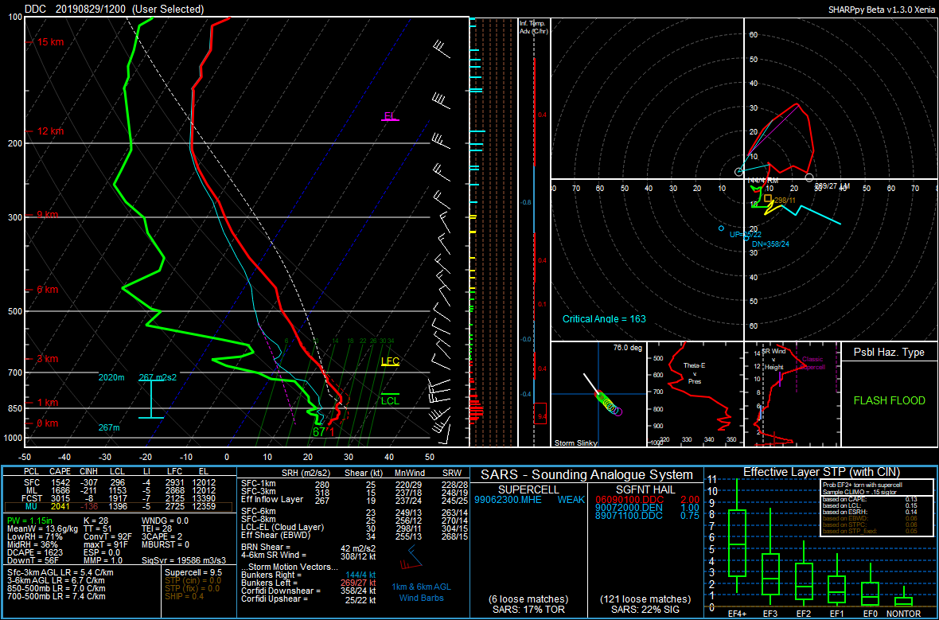
12 Z Observed
Notes:
Let’s take a look at the observed soundings. Notice the steep lapse rates? Now let’s adjust them based on recent surface observations from near the surface boundary.
This gives us an approximate picture of what the thermo environment looks like.

Slide 44
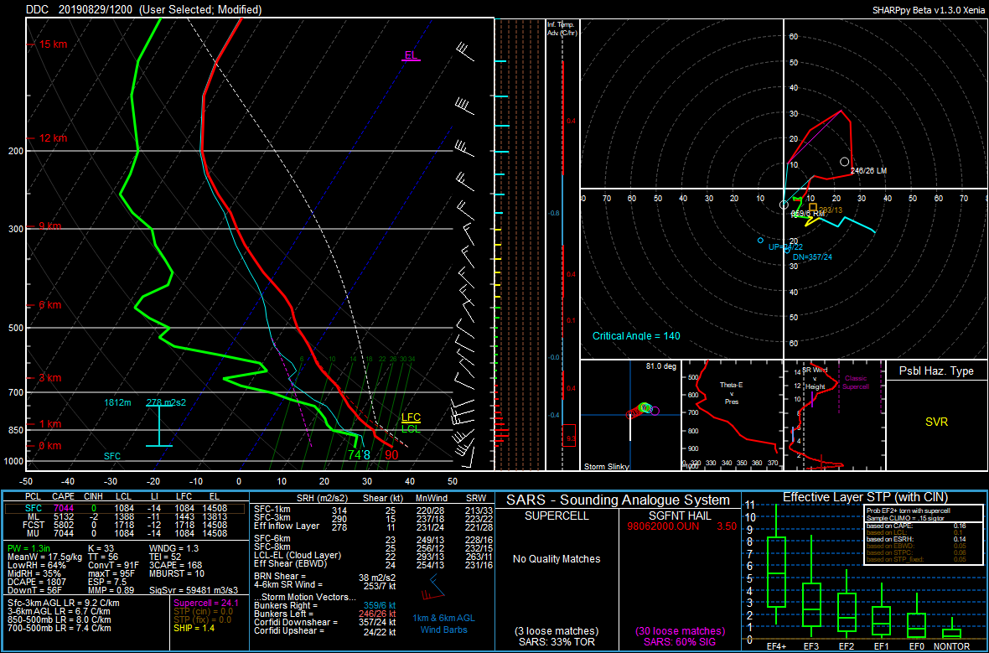
12 Z Modified
(based on 21 Z surface obs)
Notes:
Steep lapse rates
Little to no CIN; large CAPE
  (likely an overestimate!)
Poor Bulk 0-6 km bulk shear
Sufficient ESRH?
Notes:
Let’s take a look at the observed soundings. Notice the steep lapse rates? Now let’s adjust them based on recent surface observations from near the surface boundary.
This gives us an approximate picture of what the thermo environment looks like.

Slide 45
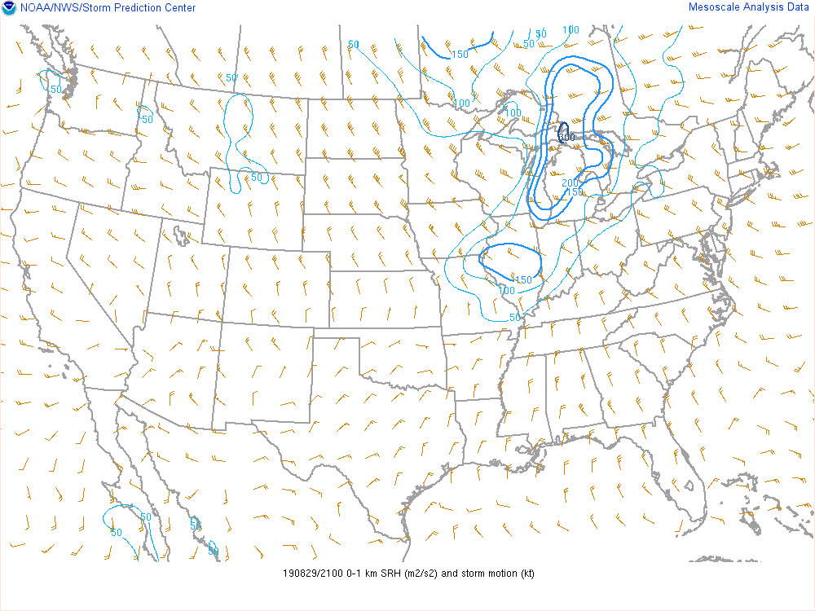
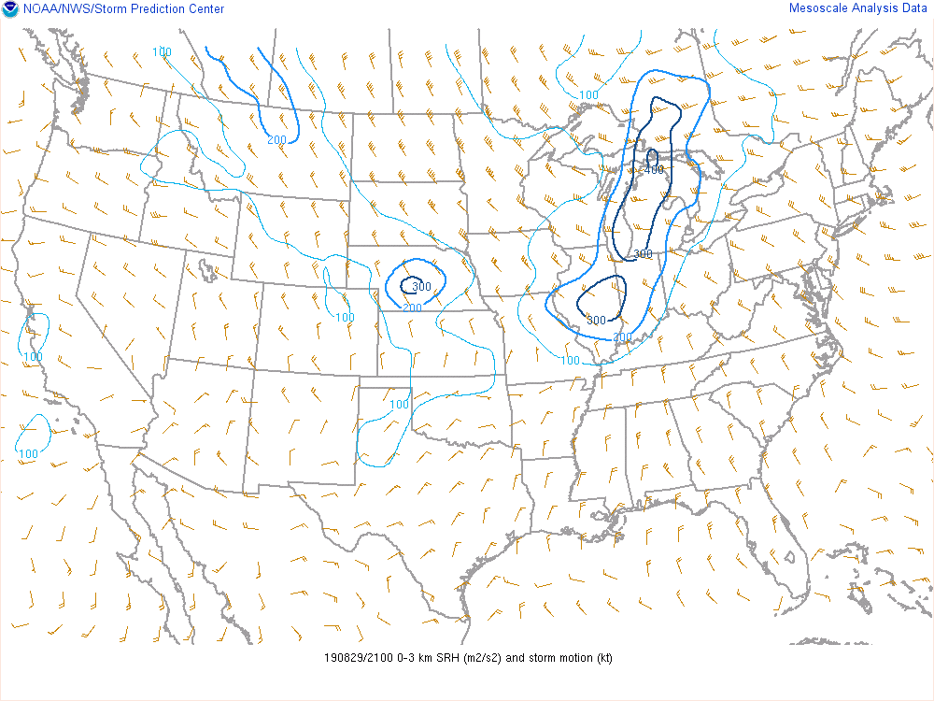
August 29, 2019 21 UTC
300 m2/s2 SRH behind the boundary!
Q: Are these high values of Storm Relative Helicity?
Notes:
A: Low values in the 0-1 km layer, and modest to high values in the 0-3 km layer (though note that the highest SRH is BEHIND the boundary!

Slide 46
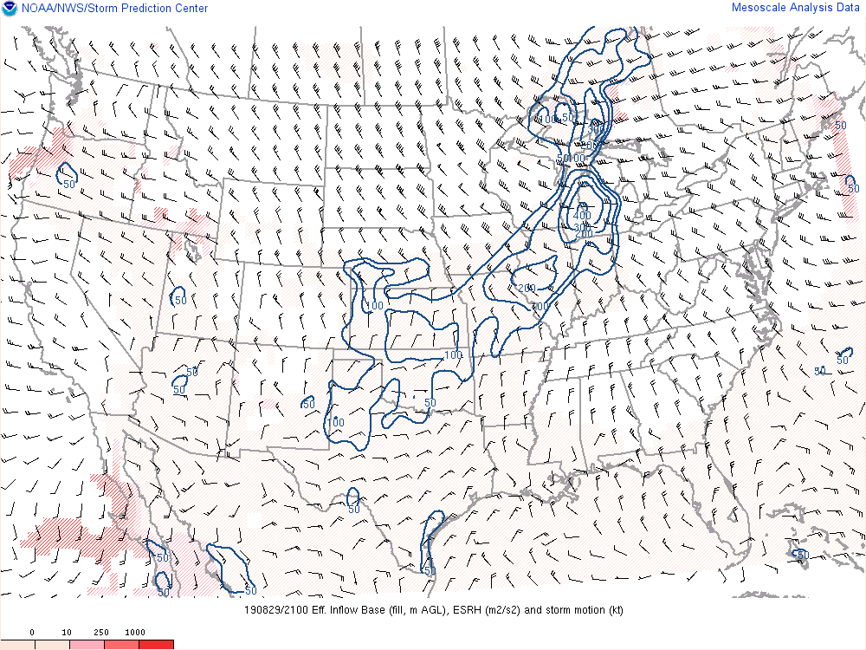
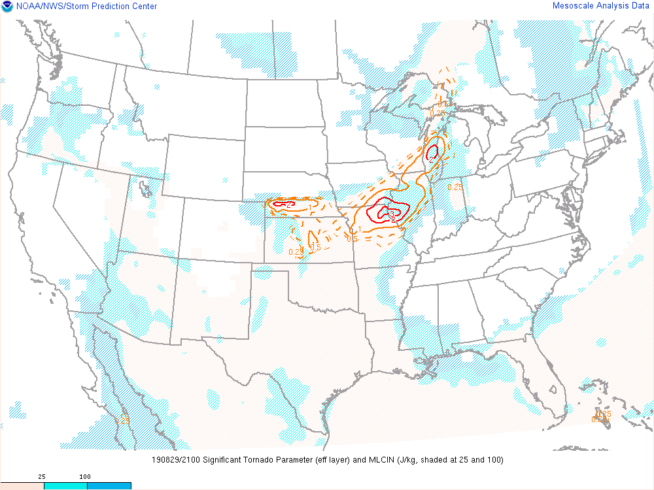
August 29, 2019 21 UTC
Q: Are these high values of ESRH/STP?
Notes:
A: These are modest values. The STP value of 2 should be viewed skeptically since it’s such a small bullseye.

Slide 47
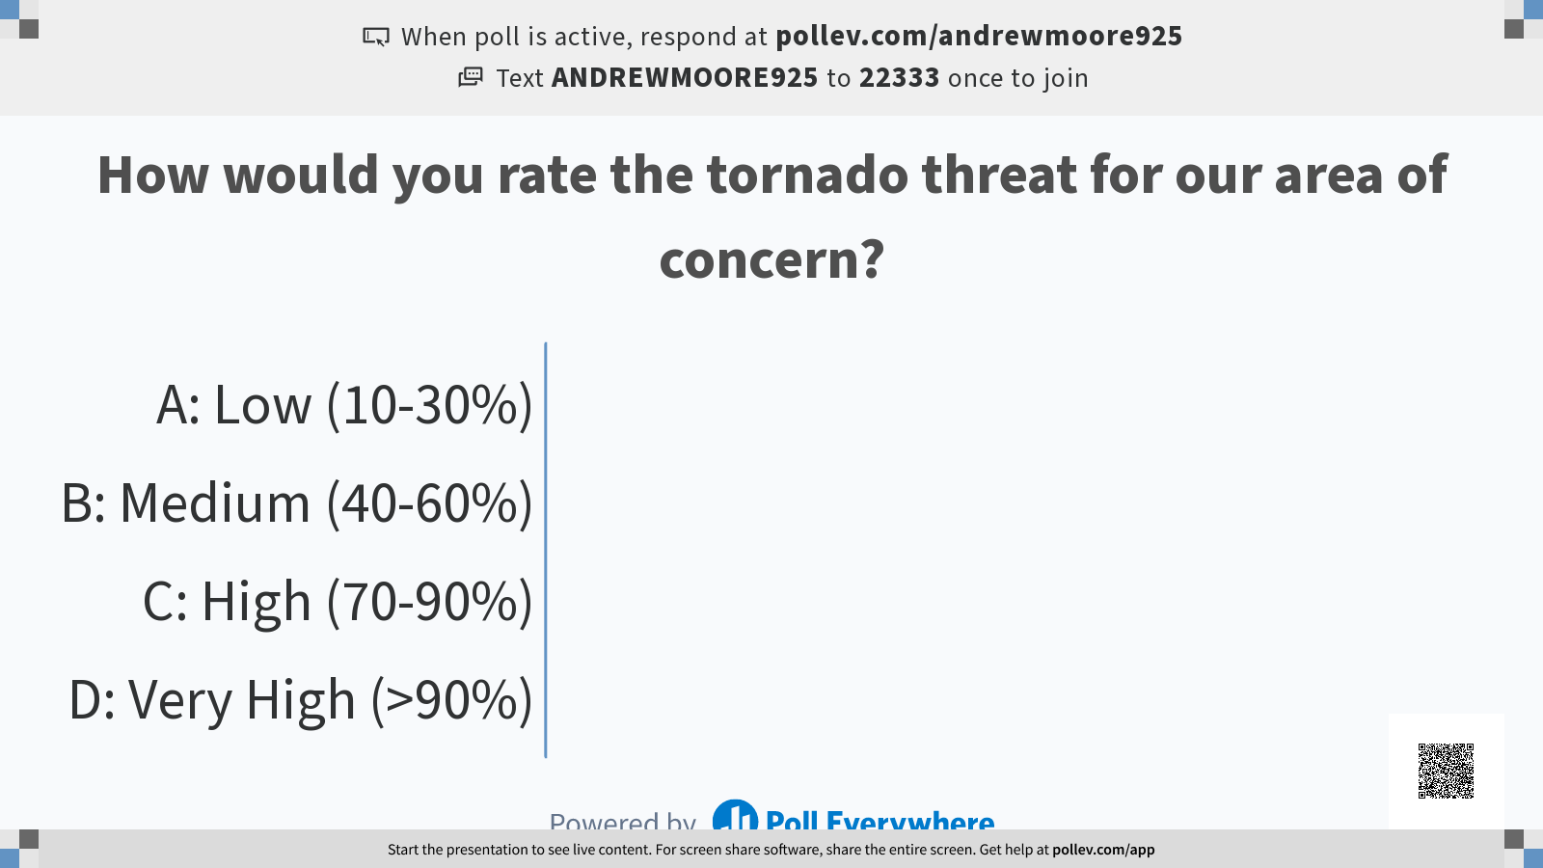

Slide 48
Tornado threat so far:
Parameter | Value | Subjective Ranking*
*The subjective ranking is largely based on the parameter’s tornado climatology. This is available on the SPC Mesoanalysis website.
Notes:
Based on parameter space alone, the 2% tornado threat appears appropriate.

Slide 49
Tornado threat so far:
Parameter | Value | Subjective Ranking*
0-1 km SRH | Near 0 | Low
*The subjective ranking is largely based on the parameter’s tornado climatology. This is available on the SPC Mesoanalysis website.
Notes:
Based on parameter space alone, the 2% tornado threat appears appropriate.

Slide 50
Tornado threat so far:
Parameter | Value | Subjective Ranking*
0-1 km SRH | Near 0 | Low
0-3 km SRH | 100-200 m2/s2 | Medium
*The subjective ranking is largely based on the parameter’s tornado climatology. This is available on the SPC Mesoanalysis website.
Notes:
Based on parameter space alone, the 2% tornado threat appears appropriate.

Slide 51
Tornado threat so far:
Parameter | Value | Subjective Ranking*
0-1 km SRH | Near 0 | Low
0-3 km SRH | 100-200 m2/s2 | Medium
ESRH | Near 100 m2/s2 | Low
*The subjective ranking is largely based on the parameter’s tornado climatology. This is available on the SPC Mesoanalysis website.
Notes:
Based on parameter space alone, the 2% tornado threat appears appropriate.

Slide 52
Tornado threat so far:
Parameter | Value | Subjective Ranking*
0-1 km SRH | Near 0 | Low
0-3 km SRH | 100-200 m2/s2 | Medium
ESRH | Near 100 m2/s2 | Low
STP | 0-1 | Low-Medium
*The subjective ranking is largely based on the parameter’s tornado climatology. This is available on the SPC Mesoanalysis website.
Notes:
Based on parameter space alone, the 2% tornado threat appears appropriate.

Slide 53
Tornado threat so far:
Parameter | Value | Subjective Ranking*
0-1 km SRH | Near 0 | Low
0-3 km SRH | 100-200 m2/s2 | Medium
ESRH | Near 100 m2/s2 | Low
STP | 0-1 | Low-Medium
Overall Environment: High CAPE/Low Shear
Does the SPC tornado risk seem appropriate?
*The subjective ranking is largely based on the parameter’s tornado climatology. This is available on the SPC Mesoanalysis website.
Notes:
Based on parameter space alone, the 2% tornado threat appears appropriate.

Slide 54
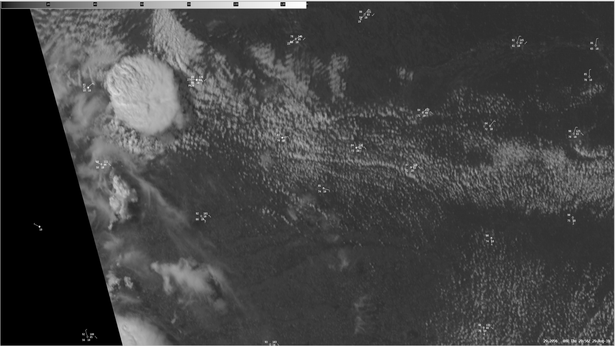
GOES-16 Ch. 2 (Red Vis) 20:56 Z
Developing Thunderstorm
Towering Cumulus
Shallow Cumulus

Slide 55
GOES-16 Ch. 2 (Red Vis) 20:56 Z
Developing Thunderstorm
As a Mesoanalyst:
For the next 0-3 hours...
Which areas are at risk?
What will the storm mode be?
  Will it remain discrete?
What are the possible hazards?
  What is the tornado potential?
Now we’ll use meteorological concepts to create a short-term forecast!

Slide 56
GOES-16 Ch. 2 (Red Vis) 20:56 Z
Notes:
Let’s highlight our surface wind field.

Slide 57
GOES-16 Ch. 2 (Red Vis) 20:56 Z
L
Notes:
Does this reveal anything? There may be a few confluence axes, as well as a surface low near the developing thunderstorm. Let’s mark it with an “L”!

Slide 58
80
GOES-16 Ch. 2 (Red Vis) 20:56 Z
78
82
83
85
81
84
L
84
83
90
84
88
87
85
92
90
90
92
93
Notes:
Now let’s add on temperatures. Notice the cooler airmass in the north vs. the warmer air mass in the south. While not drastic, this does support the idea of a stationary boundary.

Slide 59
80
GOES-16 Ch. 2 (Red Vis) 20:56 Z
78
82
83
85
81
84
L
84
83
90
84
88
87
85
92
90
90
92
93
Notes:
Let’s denote the stationary boundary by this blue line.

Slide 60
80
GOES-16 Ch. 2 (Red Vis) 20:56 Z
78
59
82
61
86
60
65
83
85
81
70
66
59
84
L
71
84
83
90
84
72
70
88
74
71
87
58
72
85
74
92
66
90
75
90
74
92
56
93
Notes:
Now let’s add on dewpoints. Notice the drier air in the north, moist air in the south. There is also a drier airmass with westerly winds on the western portion of the map.

Slide 61
80
GOES-16 Ch. 2 (Red Vis) 20:56 Z
78
59
82
61
86
60
65
83
85
81
70
66
59
84
L
71
84
83
90
84
72
70
88
74
71
87
58
72
85
74
92
66
90
75
90
74
92
56
93
Notes:
This is likely denoting where the lee trough (perhaps weak dryline) is located. Notice that this also corresponds with the location of the towering cumulus.

Slide 62
80
GOES-16 Ch. 2 (Red Vis) 20:56 Z
78
59
82
61
86
60
65
Area of Concern for the next 0-3 hours
83
85
81
70
66
59
84
L
71
84
83
90
84
72
70
88
74
71
87
58
72
85
74
92
66
90
75
90
74
92
56
93
Notes:
This is likely denoting where the lee trough (perhaps weak dryline) is located. Notice that this also corresponds with the location of the towering cumulus.

Slide 63
80
GOES-16 Ch. 2 (Red Vis) 20:56 Z
78
59
82
61
86
60
65
Area of Concern for the next 0-3 hours
83
85
81
70
66
59
84
L
71
84
83
90
84
72
70
As a Mesoanalyst:
For the next 0-3 hours...
Which areas are at risk?
What will the storm mode be?
  Will it remain discrete?
What are the possible hazards?
  What is the tornado potential?
Now we’ll use meteorological concepts to create a short-term forecast!
88
74
71
87
58
72
85
74
92
66
90
75
90
74
92
56
93
Notes:
This is likely denoting where the lee trough (perhaps weak dryline) is located. Notice that this also corresponds with the location of the towering cumulus.

Slide 64
Storm Mode In a nutshell
Storm mode is a function of:
Boundary-relative storm motion
  Storms move off boundary => favorable for discrete
  Storms stay on/move along boundary => favorable for linear
For details: Dial et al. 2010, Short-term Convective Mode Evolution along Synoptic Boundaries
Notes:
Based on parameter space alone, the 2% tornado threat appears appropriate.

Slide 65
Storm Mode In a nutshell
Storm mode is a function of:
Boundary-relative storm motion
  Storms move off boundary => favorable for discrete
  Storms stay on/move along boundary => favorable for linear
Orientation of deep layer shear vector relative to the boundary
  Shear vector off boundary => storm orients off-boundary => favorable for discrete
  Shear vector along boundary => storm orients along boundary => favorable for linear
For details: Dial et al. 2010, Short-term Convective Mode Evolution along Synoptic Boundaries
Notes:
Based on parameter space alone, the 2% tornado threat appears appropriate.

Slide 66
Storm Mode In a nutshell
Storm mode is a function of:
Boundary-relative storm motion
  Storms move off boundary => favorable for discrete
  Storms stay on/move along boundary => favorable for linear
Orientation of deep layer shear vector relative to the boundary
  Shear vector off boundary => storm orients off-boundary => favorable for discrete
  Shear vector along boundary => storm orients along boundary => favorable for linear
Anvil level storm-relative winds
  Winds off boundary => Anvil debris less likely to “seed” neighboring storms along boundary => discrete
  Winds along boundary => Anvil debris more likely to “seed” neighboring storms along boundary => linear
For details: Dial et al. 2010, Short-term Convective Mode Evolution along Synoptic Boundaries
Notes:
Based on parameter space alone, the 2% tornado threat appears appropriate.

Slide 67
Storm Mode In a nutshell
Storm mode is a function of:
Boundary-relative storm motion
  Storms move off boundary => favorable for discrete
  Storms stay on/move along boundary => favorable for linear
Orientation of deep layer shear vector relative to the boundary
  Shear vector off boundary => storm orients off-boundary => favorable for discrete
  Shear vector along boundary => storm orients along boundary => favorable for linear
Anvil level storm-relative winds
  Winds off boundary => Anvil debris less likely to “seed” neighboring storms along boundary => discrete
  Winds along boundary => Anvil debris more likely to “seed” neighboring storms along boundary => linear
Strength of the forcing for ascent
  Weak forcing for ascent => fewer storms => favorable for discrete
  Strong forcing for ascent => more storms => favorable for linear
For details: Dial et al. 2010, Short-term Convective Mode Evolution along Synoptic Boundaries
Notes:
Based on parameter space alone, the 2% tornado threat appears appropriate.

Slide 68
GOES-16 Ch. 2 (Red Vis) 20:56 Z
Storm Mode: boundary-relative storm motion
Both boundaries are nearly stationary
(Boundary motion = 0 knots 000 deg)

Slide 69
GOES-16 Ch. 2 (Red Vis) 20:56 Z
Plot Boundary motion here
Storm Mode: boundary-relative storm motion
BM
The storm is just beginning, so tracking via radar is difficult.
Mesoanalysis suggests a storm motion of:
15-20 knots
~135 deg

Slide 70
GOES-16 Ch. 2 (Red Vis) 20:56 Z
Storm Mode: boundary-relative storm motion
BM
Storm Motion Vector
The storm motion is roughly 45 degrees off the boundary to the southeast.
This is somewhat ambiguous about storm mode.

Slide 71
Storm Mode In a nutshell
Storm mode is a function of:
Boundary-relative storm motion
  Storms move off boundary => favorable for discrete
  Storms stay on/move along boundary => favorable for linear
Orientation of deep layer shear vector relative to the boundary
  Shear vector off boundary => storm orients off-boundary => favorable for discrete
  Shear vector along boundary => storm orients along boundary => favorable for linear
Anvil level storm-relative winds
  Winds off boundary => Anvil debris less likely to “seed” neighboring storms along boundary => discrete
  Winds along boundary => Anvil debris more likely to “seed” neighboring storms along boundary => linear
Strength of the forcing for ascent
  Weak forcing for ascent => fewer storms => favorable for discrete
  Strong forcing for ascent => more storms => favorable for linear
?
For details: Dial et al. 2010, Short-term Convective Mode Evolution along Synoptic Boundaries
Notes:
Based on parameter space alone, the 2% tornado threat appears appropriate.

Slide 72
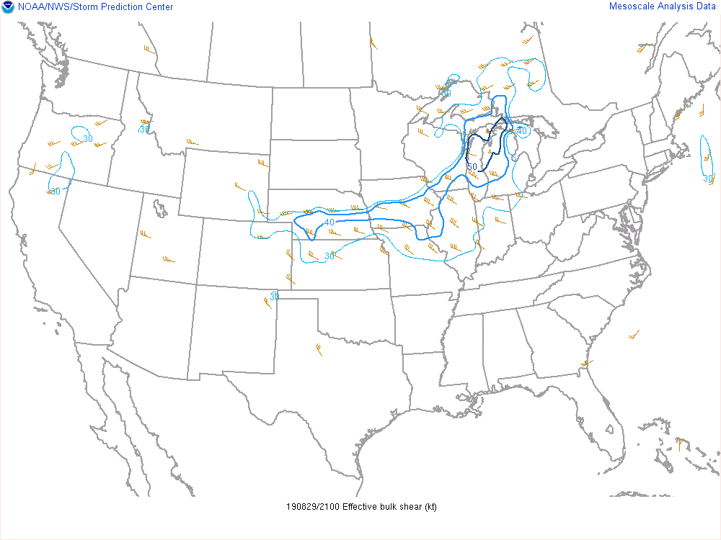
GOES-16 Ch. 2 (Red Vis) 20:56 Z
Storm Mode: Deep-layer shear vector
BM
Storm Motion Vector
Now check the Eff. Bulk Shear. Mesoanalysis suggests a near-storm bulk shear vector:
40 knots
~120 deg

Slide 73
GOES-16 Ch. 2 (Red Vis) 20:56 Z
Storm Mode: Deep-layer shear vector
BM
Eff. Bulk Shear
Vector
Storm Motion Vector
The effective bulk shear vector is more parallel to the initiating boundary.
This pushes us closer to the “linear” side.

Slide 74
Storm Mode In a nutshell
Storm mode is a function of:
Boundary-relative storm motion
  Storms move off boundary => favorable for discrete
  Storms stay on/move along boundary => favorable for linear
Orientation of deep layer shear vector relative to the boundary
  Shear vector off boundary => storm orients off-boundary => favorable for discrete
  Shear vector along boundary => storm orients along boundary => favorable for linear
Anvil level storm-relative winds
  Winds off boundary => Anvil debris less likely to “seed” neighboring storms along boundary => discrete
  Winds along boundary => Anvil debris more likely to “seed” neighboring storms along boundary => linear
Strength of the forcing for ascent
  Weak forcing for ascent => fewer storms => favorable for discrete
  Strong forcing for ascent => more storms => favorable for linear
?
For details: Dial et al. 2010, Short-term Convective Mode Evolution along Synoptic Boundaries
Notes:
Based on parameter space alone, the 2% tornado threat appears appropriate.

Slide 75
GOES-16 Ch. 2 (Red Vis) 20:56 Z
Storm Mode: Anvil-level storm-relative winds
BM
Eff. Bulk Shear
Vector
Storm Motion Vector
Use sounding to get an approximation of the anvil-level SR winds:
~25 knots
~ 135 deg

Slide 76
GOES-16 Ch. 2 (Red Vis) 20:56 Z
Storm Mode: Anvil-level storm-relative winds
BM
Eff. Bulk Shear
Vector
Storm Motion Vector (purple)
Anvil-level SR Wind
Vector (blue)
The anvil-level SR wind is about 45 degrees
off the boundary.
Somewhat ambiguous about storm mode.

Slide 77
Storm Mode In a nutshell
Storm mode is a function of:
Boundary-relative storm motion
  Storms move off boundary => favorable for discrete
  Storms stay on/move along boundary => favorable for linear
Orientation of deep layer shear vector relative to the boundary
  Shear vector off boundary => storm orients off-boundary => favorable for discrete
  Shear vector along boundary => storm orients along boundary => favorable for linear
Anvil level storm-relative winds
  Winds off boundary => Anvil debris less likely to “seed” neighboring storms along boundary => discrete
  Winds along boundary => Anvil debris more likely to “seed” neighboring storms along boundary => linear
Strength of the forcing for ascent
  Weak forcing for ascent => fewer storms => favorable for discrete
  Strong forcing for ascent => more storms => favorable for linear
?
?
For details: Dial et al. 2010, Short-term Convective Mode Evolution along Synoptic Boundaries
Notes:
Based on parameter space alone, the 2% tornado threat appears appropriate.

Slide 78
80
GOES-16 Ch. 2 (Red Vis) 20:56 Z
78
59
82
61
86
Storm mode: Forcing For Ascent
60
65
83
85
81
70
66
59
84
L
71
84
83
90
84
72
70
88
74
71
87
58
72
85
74
92
66
90
75
90
74
92
56
93
Notes:
This is likely denoting where the lee trough (perhaps weak dryline) is located. Notice that this also corresponds with the location of the towering cumulus.

Slide 79
80
GOES-16 Ch. 2 (Red Vis) 20:56 Z
78
59
82
61
86
Storm mode: Forcing For Ascent
60
65
83
85
81
70
66
59
84
L
71
84
83
90
84
72
70
88
74
71
87
58
72
85
74
92
66
90
75
90
74
Unstable
Less steep low-level lapse rates
Lower LCLs
Confluence along boundary
Evidence of ongoing lift
Watch for additional near-term convective development
92
56
93
Notes:
This is likely denoting where the lee trough (perhaps weak dryline) is located. Notice that this also corresponds with the location of the towering cumulus.

Slide 80
80
GOES-16 Ch. 2 (Red Vis) 20:56 Z
78
59
82
61
86
Storm mode: Forcing For Ascent
60
65
83
85
81
70
66
59
84
L
71
84
83
90
84
72
70
88
74
71
87
58
72
85
74
92
66
90
75
90
74
Likely unstable
Less Evidence of ongoing lift
Higher LCLs/Deeper boundary layer
Steeper low-level lapse rates
  Note dewpoint depression
  May support wind threat
Near-term convection less likely
Unstable
Less steep low-level lapse rates
Lower LCLs
Confluence along boundary
Evidence of ongoing lift
Watch for additional near-term convective development
92
56
93
Notes:
This is likely denoting where the lee trough (perhaps weak dryline) is located. Notice that this also corresponds with the location of the towering cumulus.

Slide 81
80
GOES-16 Ch. 2 (Red Vis) 20:56 Z
Unstable
Convergence along boundary
Evidence of ongoing lift
Unclear if towering cumulus will continue to grow and be sustained
  Lack of low-level cumulus field suggests deeper, drier boundary layer and more concentrated lift along boundary.
78
59
82
61
86
Storm mode: Forcing For Ascent
60
65
83
85
81
70
66
59
84
L
71
84
83
90
84
72
70
88
74
71
87
58
72
85
74
92
66
90
75
90
74
Likely unstable
Less Evidence of ongoing lift
Higher LCLs/Deeper boundary layer
Steeper low-level lapse rates
  Note dewpoint depression
  May support wind threat
Near-term convective less likely
Unstable
Less steep low-level lapse rates
Lower LCLs
Confluence along boundary
Evidence of ongoing lift
Watch for additional near-term convective development
92
56
93
Notes:
This is likely denoting where the lee trough (perhaps weak dryline) is located. Notice that this also corresponds with the location of the towering cumulus.

Slide 82
80
GOES-16 Ch. 2 (Red Vis) 20:56 Z
78
59
82
61
86
Storm mode: Forcing For Ascent
60
65
83
85
81
70
TL;DR: Additional convection possible, but uncertain. Keep monitoring.
66
59
84
L
71
84
83
90
84
72
70
88
74
71
87
58
72
85
74
92
66
90
75
90
74
TL;DR: Environment will support storms, and new convection is possible. Keep an eye on trends.
TL;DR: Environment will support storms, but new convection is unlikely.
92
56
93
Notes:
This is likely denoting where the lee trough (perhaps weak dryline) is located. Notice that this also corresponds with the location of the towering cumulus.

Slide 83
Storm Mode In a nutshell
Storm mode is a function of:
Boundary-relative storm motion
  Storms move off boundary => favorable for discrete
  Storms stay on/move along boundary => favorable for linear
Orientation of deep layer shear vector relative to the boundary
  Shear vector off boundary => storm orients off-boundary => favorable for discrete
  Shear vector along boundary => storm orients along boundary => favorable for linear
Anvil level storm-relative winds
  Winds off boundary => Anvil debris less likely to “seed” neighboring storms along boundary => discrete
  Winds along boundary => Anvil debris more likely to “seed” neighboring storms along boundary => linear
Strength of the forcing for ascent
  Weak forcing for ascent => fewer storms => favorable for discrete
  Strong forcing for ascent => more storms => favorable for linear
?
?
For details: Dial et al. 2010, Short-term Convective Mode Evolution along Synoptic Boundaries
Notes:
Based on parameter space alone, the 2% tornado threat appears appropriate.

Slide 84
Storm Mode In a nutshell
Storm mode is a function of:
Boundary-relative storm motion
  Storms move off boundary => favorable for discrete
  Storms stay on/move along boundary => favorable for linear
Orientation of deep layer shear vector relative to the boundary
  Shear vector off boundary => storm orients off-boundary => favorable for discrete
  Shear vector along boundary => storm orients along boundary => favorable for linear
Anvil level storm-relative winds
  Winds off boundary => Anvil debris less likely to “seed” neighboring storms along boundary => discrete
  Winds along boundary => Anvil debris more likely to “seed” neighboring storms along boundary => linear
Strength of the forcing for ascent
  Weak forcing for ascent => fewer storms => favorable for discrete
  Strong forcing for ascent => more storms => favorable for linear
End Result?
Inconclusive!
So what to do?
This is where you need to think in terms of a range of possible outcomes.
Best Case Scenario: The ongoing storm is the only storm that initiates,
severe threat is limited spatially.
Most Likely Scenario: The ongoing storm remains discrete for the next 1-2 hours before additional storms develop along the boundaries and the cluster grows upscale. Severe threat begins small, then expands with time.
Worst Case Scenario: Rapid upscale growth with a widespread
potential for severe weather.
?
?
For details: Dial et al. 2010, Short-term Convective Mode Evolution along Synoptic Boundaries
Notes:
Based on parameter space alone, the 2% tornado threat appears appropriate.

Slide 85
80
GOES-16 Ch. 2 (Red Vis) 20:56 Z
78
59
82
61
86
60
65
83
85
81
70
66
59
As a Mesoanalyst:
For the next 0-3 hours...
Which areas are at risk?
What will the storm mode be?
  Will it remain discrete?
What are the possible hazards?
  What is the tornado potential?
Now we’ll use meteorological concepts to create a short-term forecast!
84
L
71
84
83
90
84
72
70
88
74
71
87
58
72
85
74
92
66
90
75
90
74
92
56
93
Notes:
Let’s start answering some questions regarding storm mode: Are additional storm possible? Let’s use the satellite image to gain insight into how likely additional storm development is.

Slide 86
80
GOES-16 Ch. 2 (Red Vis) 20:56 Z
78
59
82
61
86
60
65
83
85
81
70
66
59
84
For the next 0-3 hours...
What are the possible hazards?
  What is the tornado potential?
Let’s take a closer look
than just SPC Mesoanalysis
L
71
84
83
90
84
72
70
88
74
71
87
58
72
85
74
92
66
90
75
90
74
92
56
93
Notes:
Let’s start answering some questions regarding storm mode: Are additional storm possible? Let’s use the satellite image to gain insight into how likely additional storm development is.

Slide 87
80
GOES-16 Ch. 2 (Red Vis) 20:56 Z
78
59
82
61
86
60
65
83
85
81
70
66
59
84
L
71
84
83
90
84
72
70
88
74
71
87
58
72
85
74
92
66
90
75
90
74
Notice how low-level cumulus have organized into cloud “streets”.
This gives you an idea of what the low-level wind field in the boundary-layer looks like.
92
56
93
Notes:
Let’s start answering some questions regarding storm mode: Are additional storm possible? Let’s use the satellite image to gain insight into how likely additional storm development is.

Slide 88
80
GOES-16 Ch. 2 (Red Vis) 20:56 Z
78
59
82
61
86
60
65
83
85
81
70
66
59
84
L
71
84
83
90
84
72
70
88
74
71
87
58
72
85
74
92
66
90
75
90
74
Notice how low-level cumulus have organized into cloud “streets”.
This gives you an idea of what the low-level wind field in the boundary-layer looks like.
92
56
93
Notes:
Let’s start answering some questions regarding storm mode: Are additional storm possible? Let’s use the satellite image to gain insight into how likely additional storm development is.

Slide 89
80
GOES-16 Ch. 2 (Red Vis) 20:56 Z
78
59
82
61
86
60
65
83
85
81
70
66
What do the surface and boundary-layer flow imply about our environmental wind shear near the developing storm?
59
84
L
71
84
12 Z LBF Obs.
83
90
84
72
70
88
74
71
87
58
72
85
74
92
66
90
75
90
74
92
56
93
Notes:
Let’s start answering some questions regarding storm mode: Are additional storm possible? Let’s use the satellite image to gain insight into how likely additional storm development is.

Slide 90
80
GOES-16 Ch. 2 (Red Vis) 20:56 Z
78
59
82
61
86
60
65
83
85
81
70
66
What do the surface and boundary-layer flow imply about our environmental wind shear near the developing storm?
59
84
L
71
84
12 Z LBF Obs.
83
90
84
72
70
88
74
71
87
58
700 mb Wind
(from Mesoanalysis)
72
Est. B.L. Wind
85
74
Obs. Sfc wind
92
66
90
75
Using these observations + estimated winds from Mesoanalysis, we can get a rough idea of what the near-storm SRH looks like!
90
74
500 mb Wind
(from Mesoanalysis)
92
56
93
Notes:
Let’s start answering some questions regarding storm mode: Are additional storm possible? Let’s use the satellite image to gain insight into how likely additional storm development is.

Slide 91
80
GOES-16 Ch. 2 (Red Vis) 20:56 Z
78
59
82
61
86
60
65
83
85
81
70
66
What do the surface and boundary-layer flow imply about our environmental wind shear near the developing storm?
59
84
L
71
84
12 Z LBF Obs.
83
90
84
72
70
SRH may be higher than implied by the SPC Mesoanalysis!
74
88
71
87
58
72
85
74
92
66
90
75
Using these observations + estimated winds from Mesoanalysis, we can get a rough idea of what the near-storm SRH looks like!
90
74
92
56
93
Notes:
Let’s start answering some questions regarding storm mode: Are additional storm possible? Let’s use the satellite image to gain insight into how likely additional storm development is.

Slide 92


Slide 93
Tornado threat so far:
Parameter | Value | Subjective Ranking*
0-1 km SRH | Near 0 | Low
0-3 km SRH | 100-200 m2/s2 | Medium
ESRH | Near 100 m2/s2 | Low
STP | 0-1 | Low-Medium
These values are likely higher than previously anticipated!
Is the 2% tornado risk still appropriate?
*The subjective ranking is largely based on the parameter’s tornado climatology. This is available on the SPC Mesoanalysis website.
Notes:
Based on parameter space alone, the 2% tornado threat appears appropriate.

Slide 94
Tornado threat so far:
Parameter | Value | Subjective Ranking*
0-1 km SRH | Near 0 | Low
0-3 km SRH | 100-200 m2/s2 | Medium
ESRH | Near 100 m2/s2 | Low
STP | 0-1 | Low-Medium
This is valuable information that you can communicate to the radar operator, partners, public, etc...
*The subjective ranking is largely based on the parameter’s tornado climatology. This is available on the SPC Mesoanalysis website.
Notes:
Based on parameter space alone, the 2% tornado threat appears appropriate.

Slide 95
Increasing tornado threat
in the next 1-2 hours.
Developing T-storms will pose a threat for tornadoes, severe wind, and hail.
Vulnerable and/or exposed groups should consider precautionary actions.

Slide 96
We used Mesoanalysis to add local value to the forecast!
Increasing tornado threat
in the next 1-2 hours.
Developing T-storms will pose a threat for tornadoes, severe wind, and hail.
Vulnerable and/or exposed groups should consider precautionary actions.
Notes:
We’ll start with RAP Mesoanalysis data to give us a general overview of the environment. Area of interest is southwest NE/northwest KS/northeast CO.

Slide 97
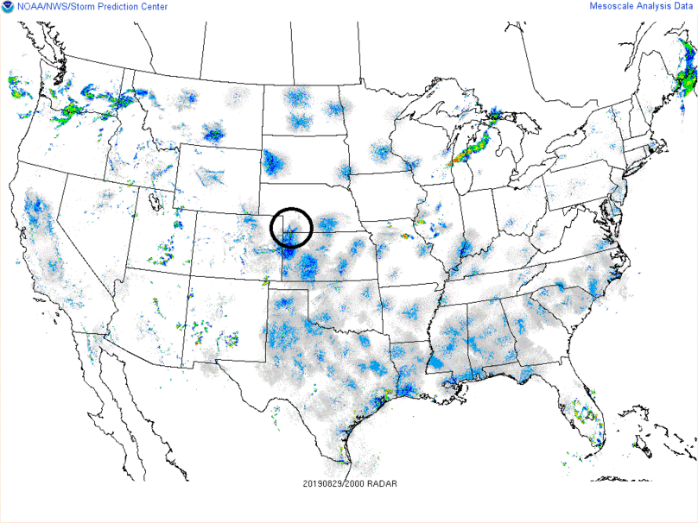
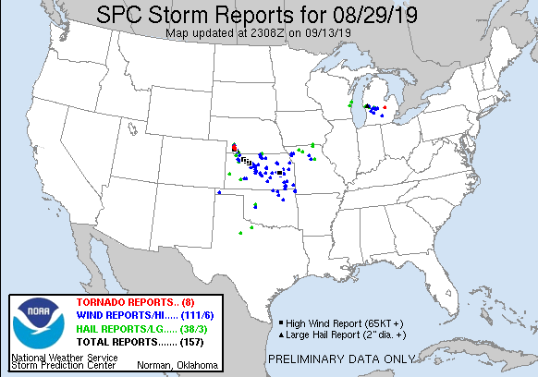
We used Mesoanalysis to add local value to the forecast!
Notes:
There were several brief, low-end tornadoes across southwest NE associated with this storm. The storm remained discrete for the first 2-3 hours of its life before additional convection developed nearby. As discussed, the boundary/shear geometry could have supported upscale growth if there was sufficient coverage of storms. In this case, the cluster did grow upscale over time, leading to several wind reports downstream across KS.

Slide 98



Mesoscale Analysis
Material by:
Harry Weinman

Slide 99
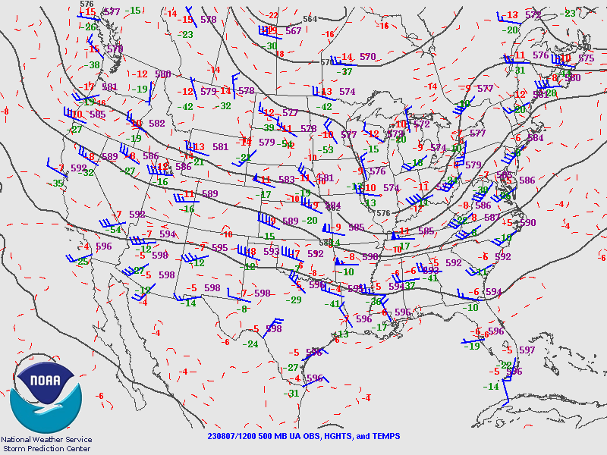
One hint: It’s the warm season
Focus here for remainder of the case

Slide 100
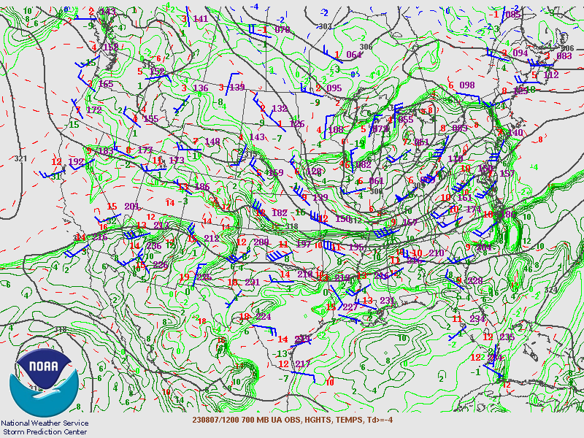

Slide 101
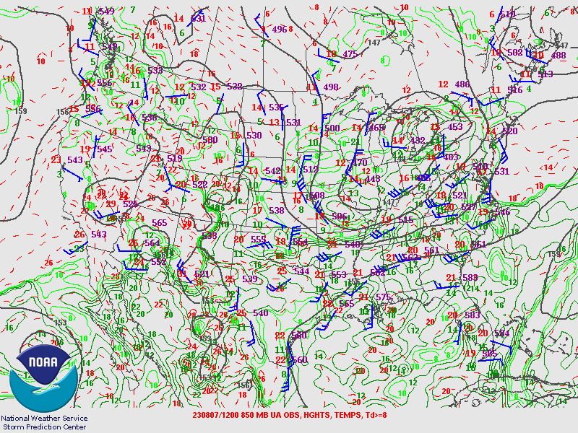

Slide 102
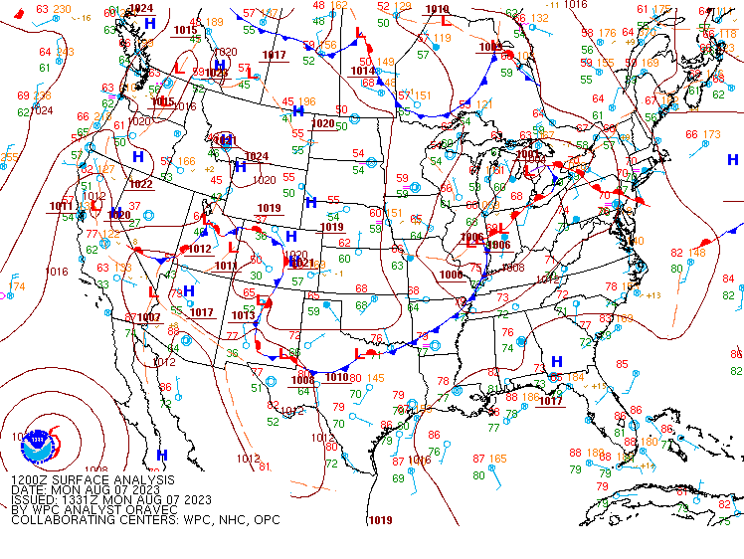

Slide 103
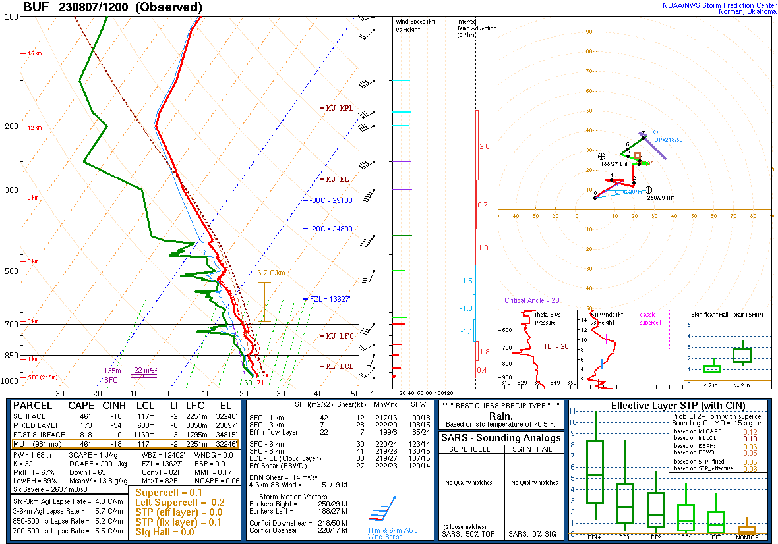
Fairly strong deep-layer flow
Deep moisture, poor lapse rates

Slide 104
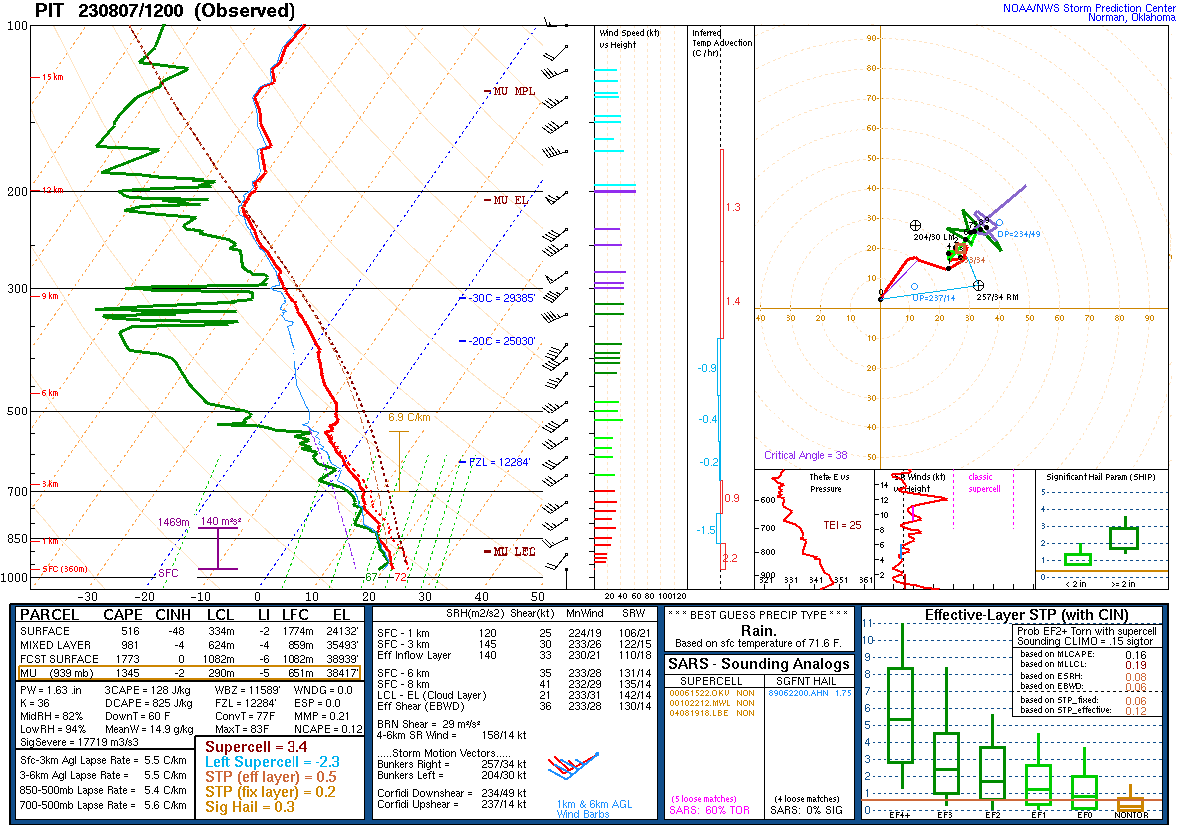
Stronger deep-layer flow/shear upstream
Slightly better lapse rates/buoyancy upstream

Slide 105
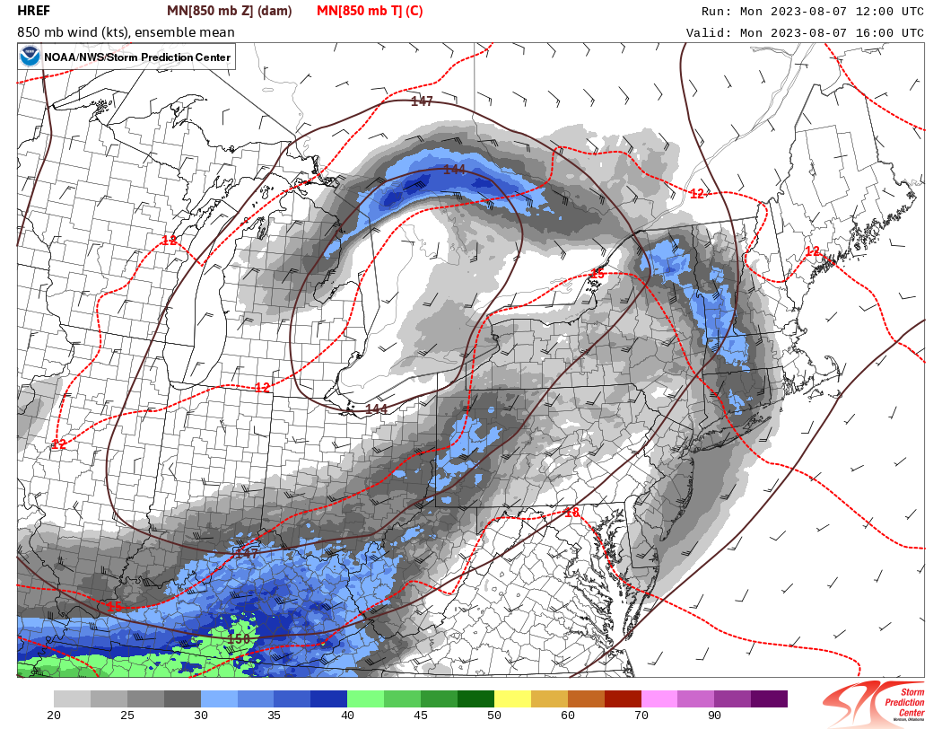
HREF 850-mb – Valid 16Z

Slide 106
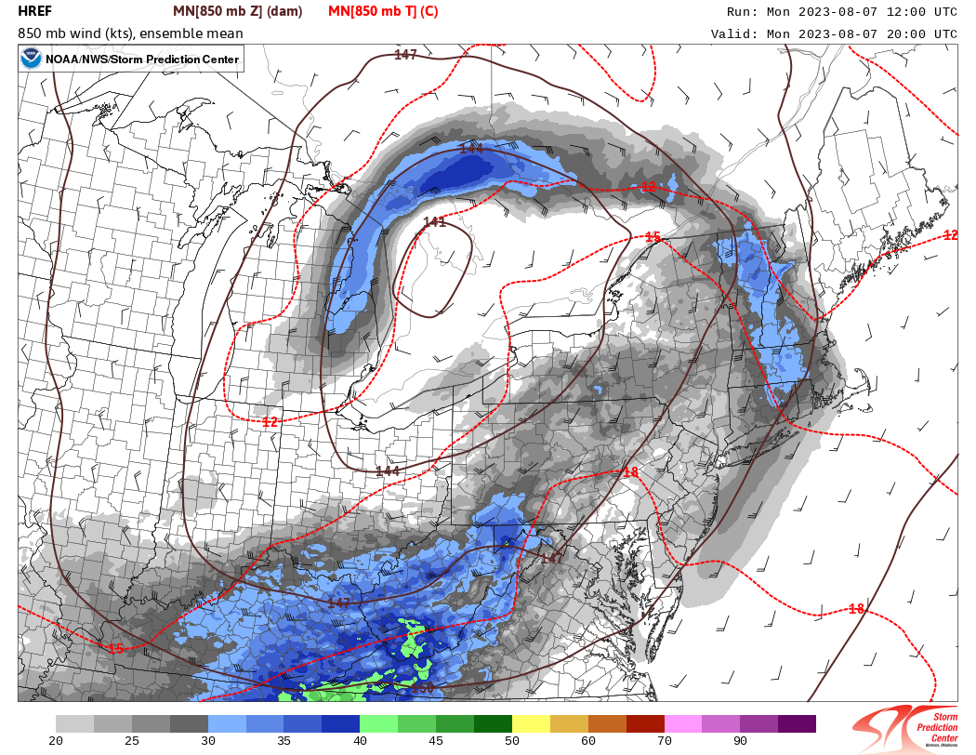
HREF 850-mb – Valid 20Z

Slide 107
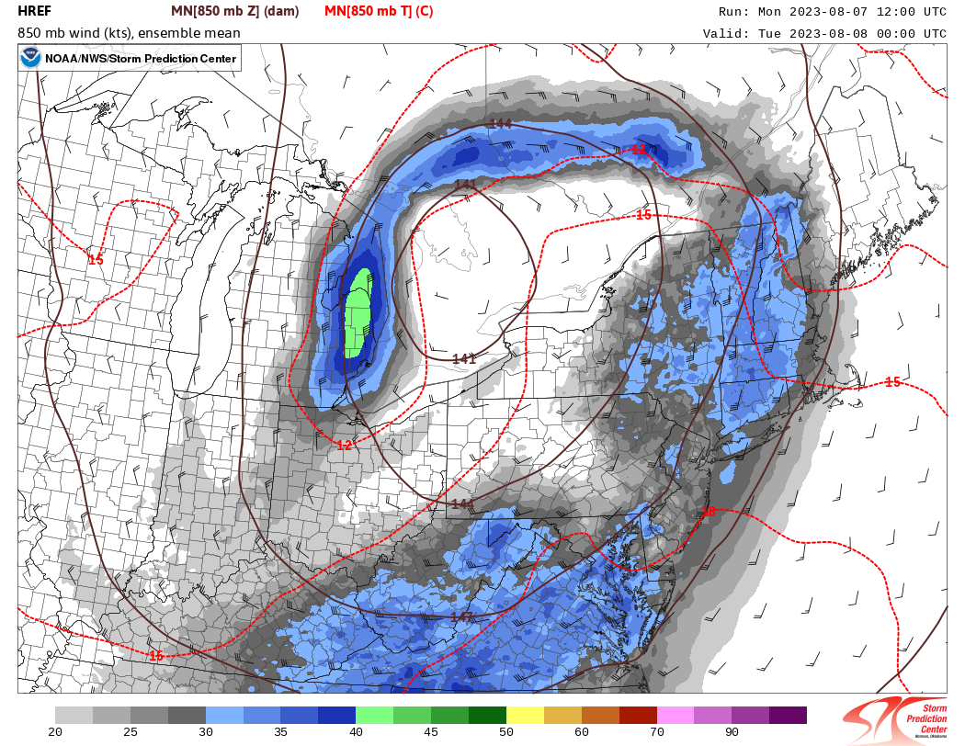
HREF 850-mb – Valid 00Z

Slide 108
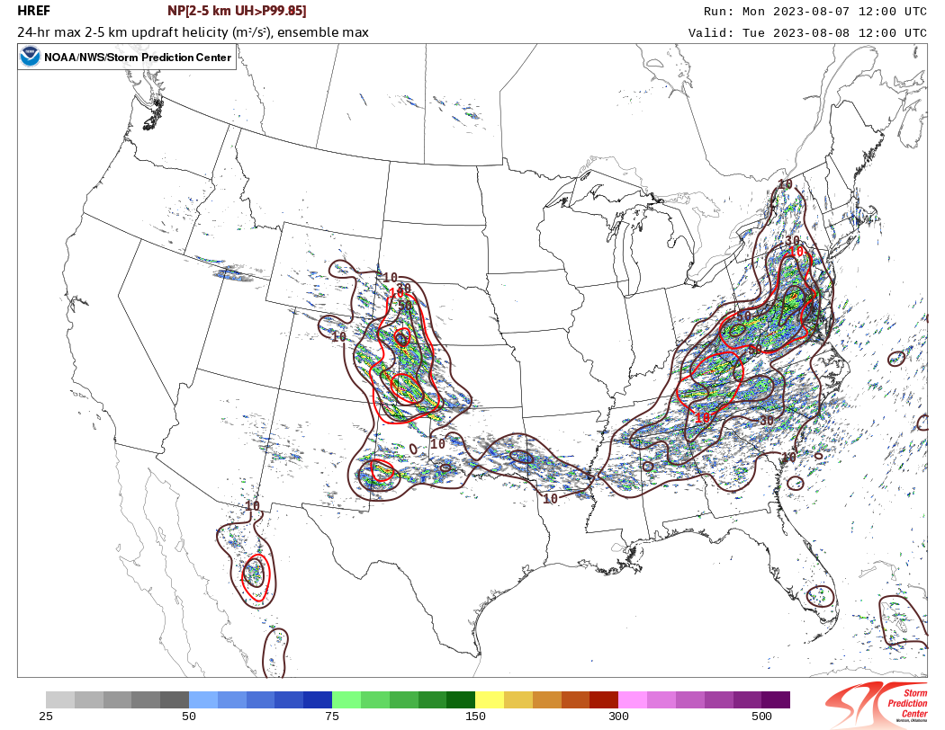
HREF 24-hr Updraft Helicity

Slide 109
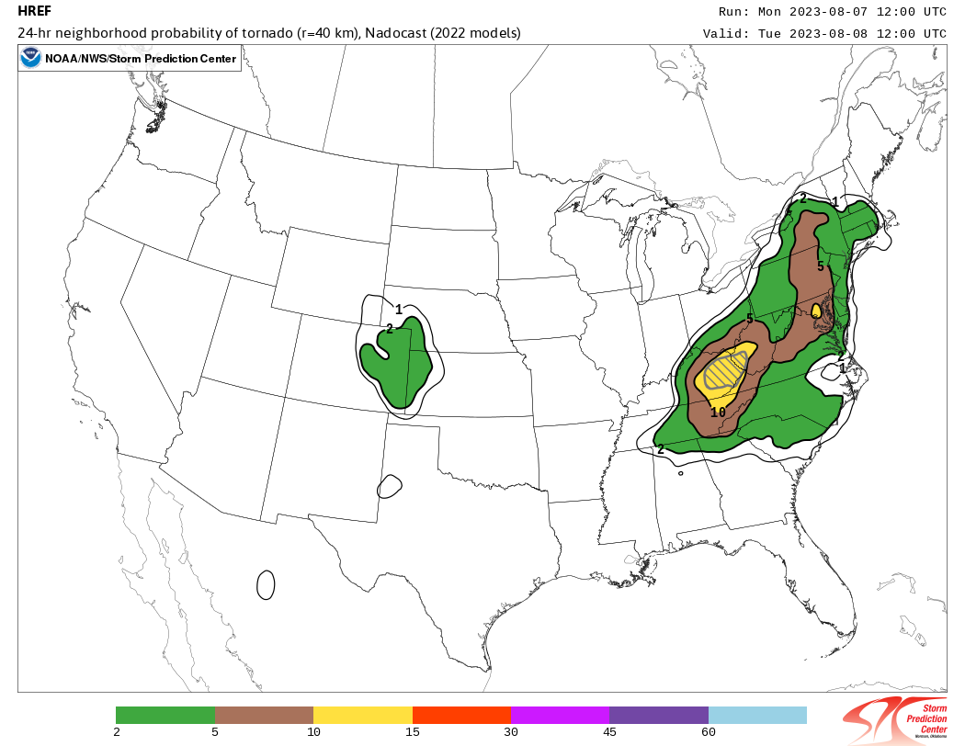
24-hr Nadocast Tor Probs

Slide 110
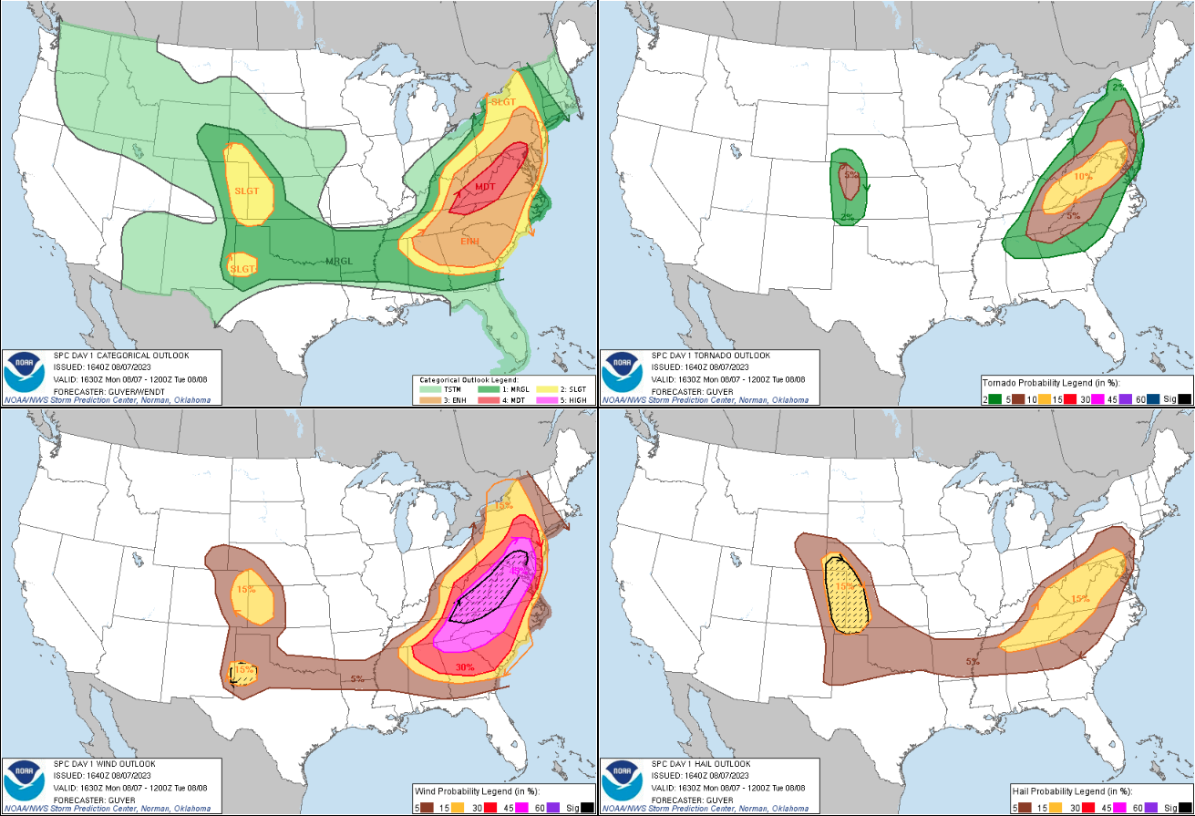
D1 1630Z Outlook
Tornado
Wind
Hail

Slide 111
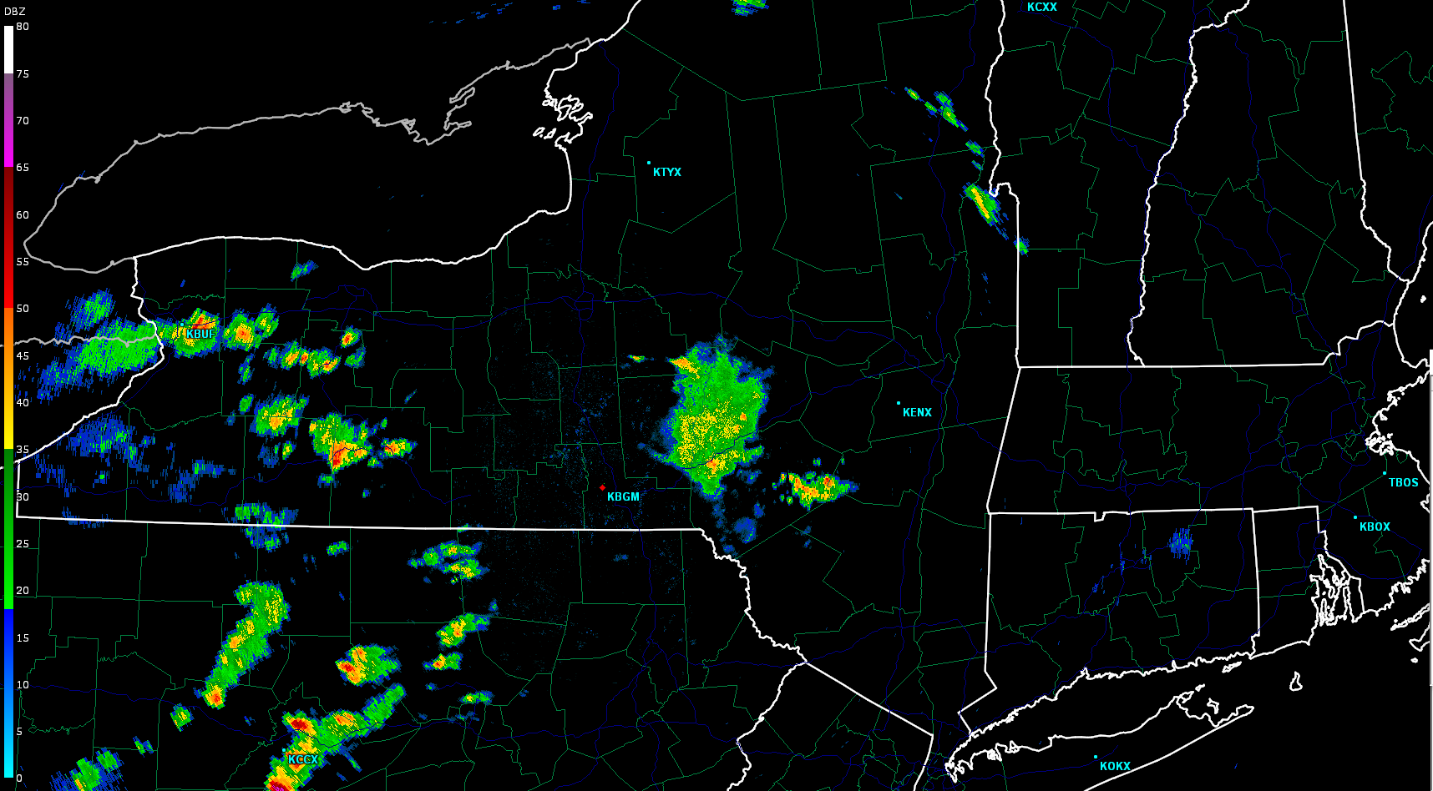
1800Z radar

Slide 112
Approaching 19Z – Lets do some Mesoanalysis!
What will the radar look like in the next 1-3 hours?
(Convective Initiation, Mode and Future Evolution)

Slide 113

Strongest midlevel flow south of our area. Still, around 30-35 kt. Left-exit region of jet.
19Z

Slide 114

Weak midlevel height falls (implied DCVA) approaching our area.
19Z

Slide 115

Modest low-level flow/mass response, though guidance suggested a gradual increase into early evening as height falls overspread.
19Z

Slide 116

Vis sat with obs/NY mesonet overlay
Western edge of “recovering” cold pool (from earlier convection)

Slide 117

Vis sat with obs/NY mesonet overlay
Western edge of “recovering” cold pool (from earlier convection)

Slide 118

Vis sat with obs/NY mesonet overlay
Western edge of “recovering” cold pool (from earlier convection)

Slide 119

Vis sat with obs/NY mesonet overlay
Western edge of “recovering” cold pool (from earlier convection)

Slide 120

Vis sat with obs/NY mesonet overlay

Slide 121

Vis sat with obs/NY mesonet overlay

Slide 122

Vis sat with obs/NY mesonet overlay

Slide 123

Vis sat with obs/NY mesonet overlay

Slide 124

Warm front
Upper 70s/lower 80s T
Recovered cold pool
Pre-frontal confluence zone
~Lower 70s Td

Slide 125
Laminar billow clouds and stratus – Lower CAPE, but more “sheltered air” (high SRH) near warm front
Increasingly “agitated” HCRs building northward (on western edge of recovering cold pool)
Zone of locally boosted SRH with CAPE
Higher CAPE, but more mixed – slightly reduced SRH?

Slide 126
Primary Heat/moisture Axis

Slide 127

Impressive heat axis developing amid richest boundary-layer moisture
(~ lower 70s dewpoints)
19Z
Warm front
Heat/moisture axis
Pre-frontal confluence zone

Slide 128
19Z
Mesoanalysis Tip:
Pay attention to temp gradients like these (always compare to surface obs)!
These can indicate baroclinic zones (mesoscale ascent) and possibly overlapping low-level shear/CAPE

Slide 129

19Z
Steepened boundary-layer lapse rates aligned with heat axis
Pre-frontal confluence zone

Slide 130
19Z
Mesoanalysis Tip:
Low-level lapse rate gradients can be helpful in identifying these potentially favorable zones as well – always compare to real obs

Slide 131

19Z
Streamline analysis helps identify/confirm subtle confluence zones

Slide 132

Weak SFC pressure falls over the warm sector.
19Z

Slide 133

19Z
Moderate (1000-1500 J/kg MLCAPE) instability over warm sector – driven by diurnal heating of moist boundary layer (midlevel lapse rates were generally poor)

Slide 134

30-35 kt deep shear overspreading buoyant sector – conditionally favors organized storms
19Z
Note boundary-orthogonal deep shear (for confluence zone)

Slide 135

Low-level shear/SRH fairly modest (50-100 m2/s2) – will this increase with strengthening LLJ?
19Z
Locally boosted SRH here? (vis/surface analysis).
Will SFCOA capture this?
Note boundary-orthogonal RM supercell storm motions (for confluence zone)

Slide 136

No surprise, fairly small
(yet clockwise-curved) low-level hodographs.
19Z

Slide 137
Let’s look at some forecast soundings – very helpful!

Slide 138

Valid 19Z in warm sector
Fairly small low-level hodograph (as seen in 19Z objective analysis) – sufficient deep shear
Favorable boundary-layer instability
Marginal 0-1km SRH

Slide 139

Valid 21Z in warm sector

Slide 140

Valid 23Z in warm sector
Expanding clockwise-curved low-level hodograph – associated with strengthening LLJ, and stronger deep shear
Onset of nocturnal cooling/stabilization, but earlier heating + rich moisture may offset this!
Much more favorable 0-1km SRH, reduced MLCAPE… (75/68) – too low compared to obs?

Slide 141
Piece it all together into a useful conceptual model!

Slide 142
19Z Composite Mesoanalysis
Weak midlevel height falls/implied DCVA impinging on the warm sector – favors CI AND discrete mode
Prefrontal Confluence zone:
Weak density gradient/baroclinic circulation supports separated updrafts/discrete mode
(compare to strongly forced cold front, which would encourage quicker upscale growth)
Leading edge of midlevel height falls
Heat/moisture axis
1500/1000 J/kg MLCAPE
Strengthening off-boundary deep shear AND storm motions:
Storms get OFF the boundary, and given slow-moving boundary, – discrete mode favored
Strengthening deep shear
Warm front (current edge of buoyant sector)
Ample width of buoyant/warm sector – plenty of convective residence time in surface-based buoyancy
Strengthening LLJ
Prefrontal Confluence zone
Strengthening LLJ yields expanding clockwise-curved low-level hodos – strongly favors RM / sustained discrete mode

Slide 143
19Z Composite Mesoanalysis
Leading edge of midlevel height falls
Heat/moisture axis
Added identified zones of potentially enhanced SRH from earlier vis/obs analysis
Strengthening deep shear
Strengthening LLJ
Prefrontal Confluence zone

Slide 144

1900Z radar
19Z: Back to our question:
What will the radar look like in the next 1-3 hours?
?

Slide 145
So what happened?

Slide 146

2100Z radar

Slide 147

2115Z radar

Slide 148

2130Z radar

Slide 149

2300Z radar

Slide 150



